Slide 1

The Growth and Impact of Alliancing as a means to Promote Value in Care Provision: The International Experience
Prof. Nick Goodwin, CEO, IFIC
Transfomers 3, Byron Bay & Coffs Harbour
November 5-8 2018

Slide 2
Alliancing: The Basics
An Alliance is an Agreement between two or more individuals/organisations stating that the involved parties will act in a certain way to achieve a common goal
Common Goal = Vision, Purpose, Objectives
Act in a Certain Way = Alliance principles, Values, Behaviours
Agreement = Alignment, Commitments & roles, Contract

Slide 3
Alliancing: Key Principles
Joint accountability
Collective responsibility for all decision and outcomes
No blame culture
Consensus-driven
Outcome-oriented (what is best for people and the system)
Efficient use of resources
Open and transparent communication
Shared process management (e.g. ACO)
Gain share and pain share – collective risk management that is either win/win or lose/lose

Slide 4
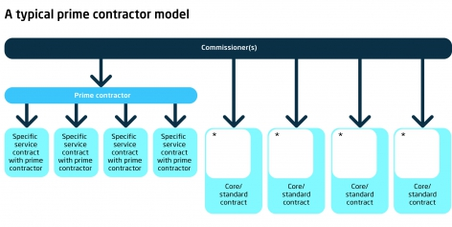
The Prime Contractor (ACO) Model
In a prime contractor model, contracts are awarded to a single organisation (or consortium) which then sub-contracts other providers. The prime contractor takes responsibility for the design and delivery of care and uses a range of sub-contracts and incentives as it wishes. Commissioner tend to use a mix of capitation and pay for outcomes. (Addicott, 2014)

Slide 5
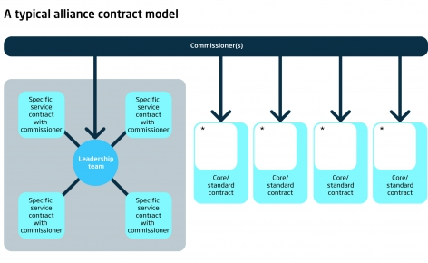
The Alliance Contractor Model
In an alliance contract, a set of providers enters into a single arrangement with a commissioner to deliver services and are legally bound together (i.e. share the risk) for achieving outcomes. Incentives are set based on system goals and outcomes. The system requires high-trust and is mutually governed through a shared board of directors. (Addicott, 2014)

Slide 6
The Alliance Contractor Model
Single Agreement
One Performance Framework - Success Judged on Overall Performance
Shared coordination and management
Collective accountability
Expectation of trust
Outcome-based
Change and innovation lies at the heart of the agreement

Slide 7
Governance

Slide 8
Performance Framework

Slide 9
Gain-share; pain-share

Slide 10
Alliance contracting is for complex problems

Slide 11
Alliances vs. Markets

Slide 12
Why and when to choose an alliance
Why choose an alliance?
To drive change
To increase innovation
To drive integration
To improve end user involvement
To be more consultative
To get more buy-in and ownership
To increase the quality of service provision and outcomes
To increase the potential for increasing value / supporting cost-reduction and elimination of waste
To mitigate risks and optimise opportunities
To promote flexibility
Suitable alliance contexts
High number of unknowns
High degree of complexity
Short timeframe
Timeframes and outcomes dependent on multiple parties
Need to become more financial sustainable
High risk from external factors
Dispersed expertise
Intention to promote value

Slide 13
Group Discussion
Identify a service that you are familiar with that might be suitable for an alliance
Discuss with your neighbour(s) why it might be suitable and what the purpose of the alliance would be

Slide 14
Lessons from the Construction Industry

Slide 15

Alliance Contracting: History
Started in early 1990s in UK North Sea Oil projects
Strategic alliances, partnerships and other attempts to drive collaboration had not changed behaviours
Move to genuine risk share through alliance contracts led to outstanding results
Since then 400+ alliances in Australasia
Health service alliance contracts have grown in USA, New Zealand (and Germany) in late 2000s
In England, first alliance contract for health and social care in April 2013 & by open market procurement in April 2014
In England & USA (Germany) ACOs and Integrated Care Systems favour Allianc-based Models

Slide 16
Lessons from the
Construction Industry
Key Problems:
Low labour productivity
Highly fragmented industry
Competitive tendering leads to adversarial contractual relationships, onerous contracts with punitive performance targets

Slide 17
Case Example: BP Andrew Project

Slide 18
Lessons from ACOs (USA)

Slide 19
Characteristics of High Performing Alliances (ACO-Model)

Slide 20
Benefits of Alliances
(when delivered well)

Slide 21
Making Alliances (ACOs) Happen

Slide 22
Key Challenges

Slide 23
The Alliance Partnership Fundamentals

Slide 24
A Question of Trusted Relationships

Slide 25
International Case Examples of Alliances in Health and Social Care

Slide 26


Case Example 1:
Stockport, England
The Stockport Mental Health Alliance, April 2013
Sharing resources and skills
Greater continuity and flexibility
Every person has chosen goals
Collaborative not competitive
Incorporates social action
Efficient, adding value, reducing duplication
Outcome driven

Slide 27
Case Example 1:
Stockport, England
Key Aims:
Ensure more vulnerable people with complex need will be enabled and supported to live well and self manage.
Reduce demand and activity for health and social care
Improve service user reported outcomes and experience
Develop and strengthen community capacity by aligning People and Place
Grow social capital and social value, more people giving time
Improve Targeted Prevention Pathways, connect the community capacity to the identified need through social action
Develop an Innovative Contract with the Voluntary sector focusing on outcomes

Slide 28
Stockport: Commissioning Options
The following options were identified for possible ways forward for the main set of preventative services
Move in house – create in house capacity to deliver the services
Multiple single providers – as now, contract with individual providers for specific scopes of work
Framework – select a range of providers and then ‘draw down’ from specific services
Single provider – identify a single provider who can cover all aspects of proposed service delivery
Prime provider – select a lead or prime provider who would manage a range of other providers through subcontracting arrangements
Consortium – invite providers to bid together as a consortium, leaving them to decide the nature of the arrangements between them
Alliance – invite bids from alliance of providers to work in a risk sharing , jointly responsible alliance with the Council

Slide 29
Stockport: Why Choose The Alliance Model
Criteria | Detail | Score
Create sustainable models and reduce dependency? | This criteria would be met through the focus on whole system outcomes which alliance members share responsibility for delivering | H
Drive integration? | Shared risk as well as delivery will promote collaboration and finding solutions through pooled expertise and approach | H
Deliver savings? | An efficient financial accountable model would be required. Building partnerships while cutting budgets is hard. The competitiveness of some organisations needs development | M
Support vulnerable groups and carers? | This option would be met as the whole system outcome set could include ones related to specific groups | H
Meet statutory requirements? | This option would meet statutory requirements | H
Level of disruption? | There would be considerable disruption in the short term but long term gain | M*
Value of diversity | The sharing of perspectives from the range of providers in the alliance would bring value | H
Market conditions | This option would require organisations to bid as alliances. This may require specific support | M*

Slide 30








Stockport Targeted Prevention Alliance
Contract in place from July 2015, value £4.5m over 3 years
Shared ‘value charter’
Outcome-driven framework
Multiple projects looking at physical. Mental and financial wellbeing and
Evaluation demonstrates improvements in mental and emotional health outcomes and a 40% more efficient use of resources.Outcomes dependent on trust and positive relationships & willingness from providers and commissioners to work flexibly in the use of resources
https://3bx16p38bchl32s0e12di03h-wpengine.netdna-ssl.com/wp-content/uploads/2017/08/Stockport-Targeted-Prevention-Programme-Evaluation-Report.pdf
https://stockporttpa.co.uk/

Slide 31
Case Example 2:
Counties Manukau, New Zealand

Slide 32
All integrated care is local!

Slide 33
General practice clusters

Slide 34
Coordinated care system

Slide 35
Impact – increasing independence

Slide 36
Impact – changing system performance

Slide 37

Case Example 3: Co-ordinated Care
Organizations in Oregon
Since 2012, Oregon Health sought to rebuild its Medicaid programme around community health rather than individual fee-for-service treatments for its 600,000 Medicaid beneficiaries
They struck a deal with the Obama government following the Affordable Care Act to gain a $1.9 billion transformation fund on the basis they could ‘save’ $11 billion over ten years (compared to projected figures on spend).
They created 16 ‘co-ordinated care organisations’, different to ACOs as they took responsibility for community health – e.g. prevention agenda and socio-determinants
Oregon Health Authority’s performance programme held back 3% of payments into a ‘quality pool’ that CCOs could access if they met 12+ of 17 quality measures and have 60% of their members enroled in a patient-centred medical home

Slide 38
Invest to Save?
http://www.oregon.gov/OHA/OHPB/meetings/2012/2012-0124-hma-report.pdf

Slide 39
ACO Results
How it works
Network of all types of health care providers in 15 geographic communities across Oregon with a single capitated budget
Shared accountability - governance to local community and payer
Development of new model of care based on PCMH-model
  Inter-disciplinary teams – health care homes
  Care transitions (hospital to home)
  Intensive transitions (mental health)
  ED navigators
  ICT investment
Impact in 2015 based on 2011 baseline
Reduced ED visits in CCOs by 22%
Reduced hospitalisations due to diabetes (26.9%) and COPD (60%)
Increased enrolment in health care homes by 56%
Oregon CCO experiment results, however, uneven – has faced significant implementation challenges

Slide 40
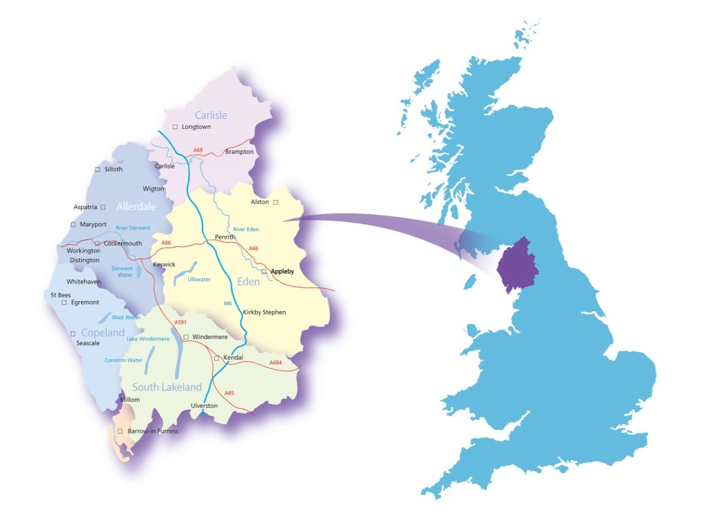
Case Example 4:
Millom, Cumbria & Morecambe Bay, UK
2014
Millom Alliance founded in rural community of 8500 people in response to closure of community hospital and crisis in GP recruitment – assets-based approach embraced
2018
Whole of Cumbria & Morecambe Bay (750k people) supported through 20 community-based alliances – fastest transforming integrated care system in the UK enabling 8-10% year on year financial savings & turnaround in population health outcomes
Millom
“Working as equal partners with the community resulted in improvements for healthcare locally highlighting the importance of co-creation”

Slide 41
The Alliance-Led
Integrated Care Equation
IHCS – the platform, leadership, architecture, culture and the right set of system rules and behaviours
Clinical Networks – teams without walls spanning acute and community
Integrated Care Communities – our neighbourhood based population health building blocks - alliances
Integrated health and social care teams
(building real teams around place and pathways)
+
Activated Individuals, carers and families
(activated individuals use services less and have better outcomes)
+
Communities mobilised at scale for health and well being
(the community as part of the local leadership and delivery team)
+
Changed drivers in the health system
(system leadership, system architecture, system culture, changed drivers, impacting on commissioning and provision)
=
A population health and wellbeing system

Slide 42
Key Conclusion:
What Makes for a Successful Alliance?
Trust and loyalty between parties
High quality decision-making processes
Alliance management, capabilities and skills
Flexibility and dynamism
A financing mechanism

