Slide 1


Slide 2


Slide 3

The Growth and Impact of Alliancing as a means to Promote Value in Care Provision: The International Experience
Prof. Nick Goodwin, CEO, IFIC
Transfomers 3, Byron Bay & Coffs Harbour
November 5-8 2018

Slide 4
Alliancing: The Basics
An Alliance is an Agreement between two or more individuals/organisations stating that the involved parties will act in a certain way to achieve a common goal
Common Goal = Vision, Purpose, Objectives
Act in a Certain Way = Alliance principles, Values, Behaviours
Agreement = Alignment, Commitments & roles, Contract

Slide 5
Alliancing: Key Principles
Joint accountability
Collective responsibility for all decision and outcomes
No blame culture
Consensus-driven
Outcome-oriented (what is best for people and the system)
Efficient use of resources
Open and transparent communication
Shared process management (e.g. ACO)
Gain share and pain share – collective risk management that is either win/win or lose/lose

Slide 6
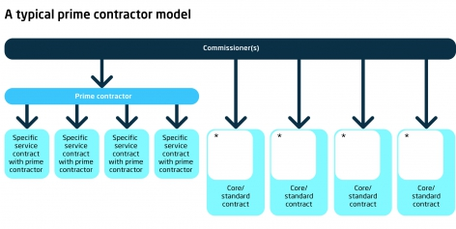
The Prime Contractor (ACO) Model
In a prime contractor model, contracts are awarded to a single organisation (or consortium) which then sub-contracts other providers. The prime contractor takes responsibility for the design and delivery of care and uses a range of sub-contracts and incentives as it wishes. Commissioner tend to use a mix of capitation and pay for outcomes. (Addicott, 2014)

Slide 7
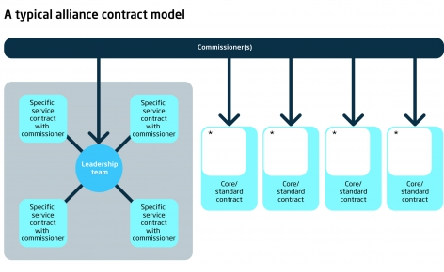
The Alliance Contractor Model
In an alliance contract, a set of providers enters into a single arrangement with a commissioner to deliver services and are legally bound together (i.e. share the risk) for achieving outcomes. Incentives are set based on system goals and outcomes. The system requires high-trust and is mutually governed through a shared board of directors. (Addicott, 2014)

Slide 8
The Alliance Contractor Model
Single Agreement
One Performance Framework - Success Judged on Overall Performance
Shared coordination and management
Collective accountability
Expectation of trust
Outcome-based
Change and innovation lies at the heart of the agreement

Slide 9
Governance

Slide 10
Performance Framework

Slide 11
Gain-share; pain-share

Slide 12
Alliance contracting is for complex problems

Slide 13
Alliances vs. Markets

Slide 14
Why and when to choose an alliance
Why choose an alliance?
To drive change
To increase innovation
To drive integration
To improve end user involvement
To be more consultative
To get more buy-in and ownership
To increase the quality of service provision and outcomes
To increase the potential for increasing value / supporting cost-reduction and elimination of waste
To mitigate risks and optimise opportunities
To promote flexibility
Suitable alliance contexts
High number of unknowns
High degree of complexity
Short timeframe
Timeframes and outcomes dependent on multiple parties
Need to become more financial sustainable
High risk from external factors
Dispersed expertise
Intention to promote value

Slide 15
Group Discussion
Identify a service that you are familiar with that might be suitable for an alliance
Discuss with your neighbour(s) why it might be suitable and what the purpose of the alliance would be

Slide 16
Lessons from the Construction Industry

Slide 17

Alliance Contracting: History
Started in early 1990s in UK North Sea Oil projects
Strategic alliances, partnerships and other attempts to drive collaboration had not changed behaviours
Move to genuine risk share through alliance contracts led to outstanding results
Since then 400+ alliances in Australasia
Health service alliance contracts have grown in USA, New Zealand (and Germany) in late 2000s
In England, first alliance contract for health and social care in April 2013 & by open market procurement in April 2014
In England & USA (Germany) ACOs and Integrated Care Systems favour Allianc-based Models

Slide 18
Lessons from the
Construction Industry
Key Problems:
Low labour productivity
Highly fragmented industry
Competitive tendering leads to adversarial contractual relationships, onerous contracts with punitive performance targets

Slide 19
Case Example: BP Andrew Project

Slide 20
Lessons from ACOs (USA)

Slide 21
Characteristics of High Performing Alliances (ACO-Model)

Slide 22
Benefits of Alliances
(when delivered well)

Slide 23
Making Alliances (ACOs) Happen

Slide 24
Key Challenges

Slide 25
The Alliance Partnership Fundamentals

Slide 26
A Question of Trusted Relationships

Slide 27
International Case Examples of Alliances in Health and Social Care

Slide 28


Case Example 1:
Stockport, England
The Stockport Mental Health Alliance, April 2013
Sharing resources and skills
Greater continuity and flexibility
Every person has chosen goals
Collaborative not competitive
Incorporates social action
Efficient, adding value, reducing duplication
Outcome driven

Slide 29
Case Example 1:
Stockport, England
Key Aims:
Ensure more vulnerable people with complex need will be enabled and supported to live well and self manage.
Reduce demand and activity for health and social care
Improve service user reported outcomes and experience
Develop and strengthen community capacity by aligning People and Place
Grow social capital and social value, more people giving time
Improve Targeted Prevention Pathways, connect the community capacity to the identified need through social action
Develop an Innovative Contract with the Voluntary sector focusing on outcomes

Slide 30
Stockport: Commissioning Options
The following options were identified for possible ways forward for the main set of preventative services
Move in house – create in house capacity to deliver the services
Multiple single providers – as now, contract with individual providers for specific scopes of work
Framework – select a range of providers and then ‘draw down’ from specific services
Single provider – identify a single provider who can cover all aspects of proposed service delivery
Prime provider – select a lead or prime provider who would manage a range of other providers through subcontracting arrangements
Consortium – invite providers to bid together as a consortium, leaving them to decide the nature of the arrangements between them
Alliance – invite bids from alliance of providers to work in a risk sharing , jointly responsible alliance with the Council

Slide 31
Stockport: Why Choose The Alliance Model
Criteria | Detail | Score
Create sustainable models and reduce dependency? | This criteria would be met through the focus on whole system outcomes which alliance members share responsibility for delivering | H
Drive integration? | Shared risk as well as delivery will promote collaboration and finding solutions through pooled expertise and approach | H
Deliver savings? | An efficient financial accountable model would be required. Building partnerships while cutting budgets is hard. The competitiveness of some organisations needs development | M
Support vulnerable groups and carers? | This option would be met as the whole system outcome set could include ones related to specific groups | H
Meet statutory requirements? | This option would meet statutory requirements | H
Level of disruption? | There would be considerable disruption in the short term but long term gain | M*
Value of diversity | The sharing of perspectives from the range of providers in the alliance would bring value | H
Market conditions | This option would require organisations to bid as alliances. This may require specific support | M*

Slide 32








Stockport Targeted Prevention Alliance
Contract in place from July 2015, value £4.5m over 3 years
Shared ‘value charter’
Outcome-driven framework
Multiple projects looking at physical. Mental and financial wellbeing and
Evaluation demonstrates improvements in mental and emotional health outcomes and a 40% more efficient use of resources.Outcomes dependent on trust and positive relationships & willingness from providers and commissioners to work flexibly in the use of resources
https://3bx16p38bchl32s0e12di03h-wpengine.netdna-ssl.com/wp-content/uploads/2017/08/Stockport-Targeted-Prevention-Programme-Evaluation-Report.pdf
https://stockporttpa.co.uk/

Slide 33
Case Example 2:
Counties Manukau, New Zealand

Slide 34
All integrated care is local!

Slide 35
General practice clusters

Slide 36
Coordinated care system

Slide 37
Impact – increasing independence

Slide 38
Impact – changing system performance

Slide 39

Case Example 3: Co-ordinated Care
Organizations in Oregon
Since 2012, Oregon Health sought to rebuild its Medicaid programme around community health rather than individual fee-for-service treatments for its 600,000 Medicaid beneficiaries
They struck a deal with the Obama government following the Affordable Care Act to gain a $1.9 billion transformation fund on the basis they could ‘save’ $11 billion over ten years (compared to projected figures on spend).
They created 16 ‘co-ordinated care organisations’, different to ACOs as they took responsibility for community health – e.g. prevention agenda and socio-determinants
Oregon Health Authority’s performance programme held back 3% of payments into a ‘quality pool’ that CCOs could access if they met 12+ of 17 quality measures and have 60% of their members enroled in a patient-centred medical home

Slide 40
Invest to Save?
http://www.oregon.gov/OHA/OHPB/meetings/2012/2012-0124-hma-report.pdf

Slide 41
ACO Results
How it works
Network of all types of health care providers in 15 geographic communities across Oregon with a single capitated budget
Shared accountability - governance to local community and payer
Development of new model of care based on PCMH-model
  Inter-disciplinary teams – health care homes
  Care transitions (hospital to home)
  Intensive transitions (mental health)
  ED navigators
  ICT investment
Impact in 2015 based on 2011 baseline
Reduced ED visits in CCOs by 22%
Reduced hospitalisations due to diabetes (26.9%) and COPD (60%)
Increased enrolment in health care homes by 56%
Oregon CCO experiment results, however, uneven – has faced significant implementation challenges

Slide 42
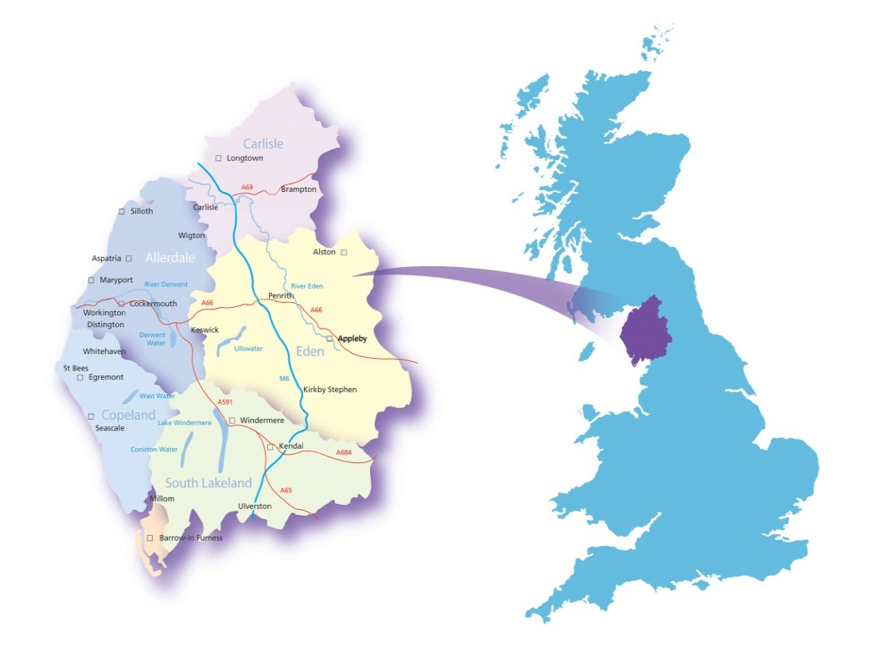
Case Example 4:
Millom, Cumbria & Morecambe Bay, UK
2014
Millom Alliance founded in rural community of 8500 people in response to closure of community hospital and crisis in GP recruitment – assets-based approach embraced
2018
Whole of Cumbria & Morecambe Bay (750k people) supported through 20 community-based alliances – fastest transforming integrated care system in the UK enabling 8-10% year on year financial savings & turnaround in population health outcomes
Millom
“Working as equal partners with the community resulted in improvements for healthcare locally highlighting the importance of co-creation”

Slide 43
The Alliance-Led
Integrated Care Equation
Integrated health and social care teams
(building real teams around place and pathways)
+
Activated Individuals, carers and families
(activated individuals use services less and have better outcomes)
+
Communities mobilised at scale for health and well being
(the community as part of the local leadership and delivery team)
+
Changed drivers in the health system
(system leadership, system architecture, system culture, changed drivers, impacting on commissioning and provision)
=
A population health and wellbeing system

Slide 44
Key Conclusion:
What Makes for a Successful Alliance?
Trust and loyalty between parties
High quality decision-making processes
Alliance management, capabilities and skills
Flexibility and dynamism
A financing mechanism

Slide 46

Developing a ‘one-team’ culture: managing alliances effectively
Dr Viktoria Stein, IFIC
Transfomers 3, Byron Bay & Coffs Harbour
November 5-8 2018

Slide 47
A Question of Trusted Relationships

Slide 48
Building trust

Slide 49
Most trusted brands in the world

Slide 50
Group Discussion
Why do we trust someone/something?
What builds our trust in:
An individual?
An organisation?
A Team?
What happens, when you don’t trust someone?

Slide 51
What is trust?
“trust serves the purpose of reducing complexity which characterizes modern societies” (Luhmann 1988)
Trust is constituted by a person’s “expectations, assumptions, or beliefs about the likelihood that another’s future action will be beneficial, favorable, or at least not detrimental to one’s interests.” (Robinson 1996, p576)
trust is encapsulated interest: “I trust you because I think [... that] you have an interest in attending to my interest because, typically, you want our relation to continue. (Hardin 2002, p4)
Trustworthiness is determined by internal motivations, such as dispositions, moral rules and internalized norms, as well as external motivations, such as institutional devices and commitments (Hardin 2002, p4)

Slide 52
Trust is determined by internal and external factors

Slide 53
The five dysfunctions of a team
Status and Ego
Low standards
Ambiguity
Artificial harmony
Invulnerability
(Lencioni 2002)

Slide 54

Look in the fridge!

Slide 55
Finding and fostering the right personalities

Slide 56

Roles of boundary spanners
boundary spanner as networker
‘… special people in networks who play a role in bringing … partners together, in breaking through red tape, and seeing things in a different way’ Williams 2002: 109.
boundary spanner as innovator
‘ creative, lateral thinking rule-breakers who … combine … visionary thinking with an appetite for opportunism’
Leadbeater & Goss 1998: 15.
Notes:
Williams P (2002) The Competent Boundary Spanner. Public Administration 80(1):103-124.
Leadbeater C, Goss S (1998) Civic entrepreneurship. London. Demos.

Slide 57
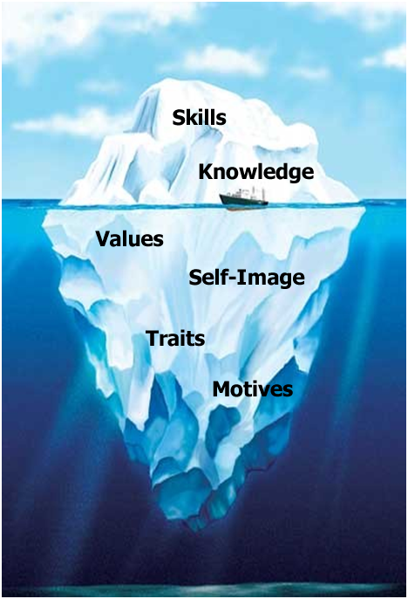
The Iceberg Model of Competencies
Can be influenced directly through education and training
Technical competencies
What we know and can do
Behavioural competencies
What we perceive and what motivates us
Attitudes
May be influenced indirectly through education and training and role models
Based on McClelland 1973

Slide 58
Competencies for integrated care:
6 key features
Competencies take time to acquire.
Competencies inform recruitment, evaluation and training.
Competencies are measurable.
Competencies must be flexible.
Competencies are not only clinical-technical skills.
Competencies are a distinguishing feature for groups.
Competent health workforce for the provision of coordinated/integrated health services. Working Document. WHO Regional Office for Europe 2015

Slide 59
5 competency clusters for integrated care
Competency Cluster | Definition
PATIENT ADVOCACY | Ability to promote patients’ entitlement to ensure the best quality of care and empowering patients to become active participants of their health
EFFECTIVE COMMUNICATION | Ability to quickly establish rapport with patients and their family members in an empathetic and sensitive manner incorporating the patients’ perceived and declared culture
TEAM WORK | Ability to function effectively as a member of an inter-professional team that includes providers, patients and family members in a way that reflects an understanding of team dynamics and group/team processes in building productive working relationships and is focused on health outcomes.
PEOPLE-CENTRED CARE | Ability to create conditions for providing coordinated/integrated services centred on the patients and their families’ needs, values and preferences along a continuum of care and over the life-course.
CONTINUOUS LEARNING | Ability to demonstrate reflective practice, based on the best available evidence and to assess and continually improve the services delivered as an individual provider and as a member of an interprofessional team.
Langins/Borgermans. Competent health workforce for the provision of coordinated/integrated health services. Working Document. WHO Regional Office for Europe 2015

Slide 60
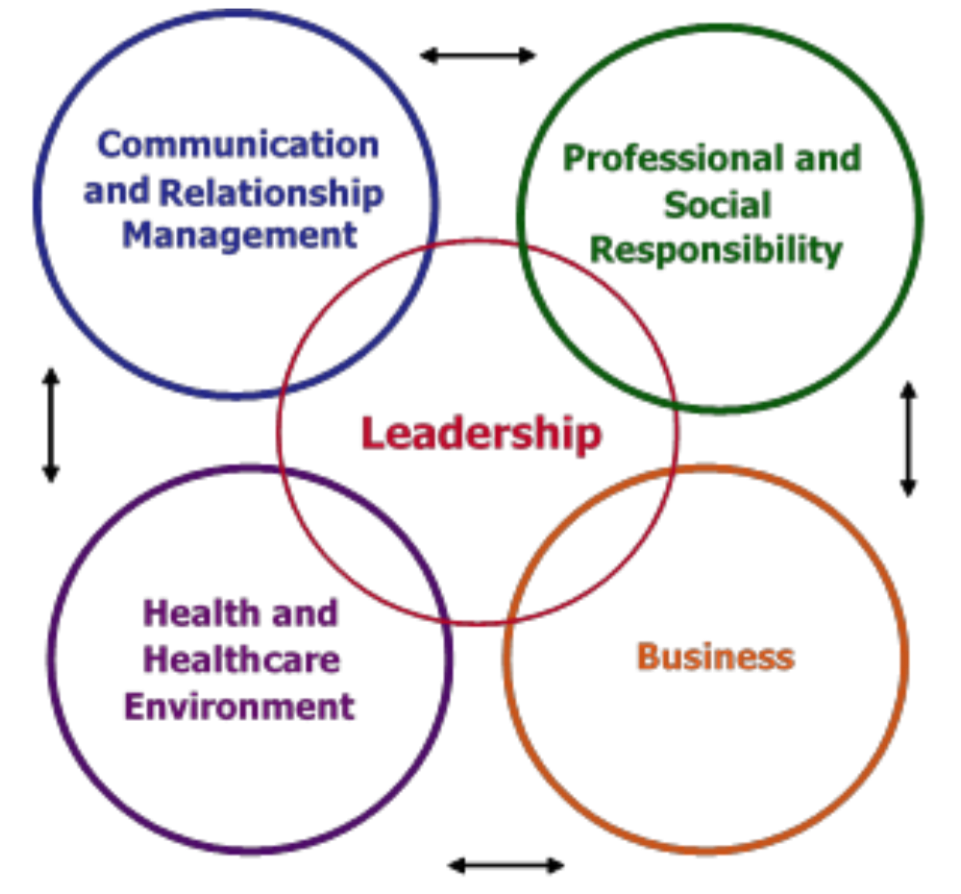
Competencies for healthcare managers
International Hospital Foundation 2015

Slide 61
Creating a continuous learning environment
Adapted from: Langins/Borgermans. Competent health workforce for the provision of coordinated/integrated health services. Working Document. WHO Regional Office for Europe 2015

Slide 62
Openness in communication

Slide 63
“The two words ‘information and ‘communication’ are often used interchangeably, but they signify quite different things. Information is giving out; communication is getting through.”
Sydney J Harris

Slide 64
Communication – what do we mean?
Communication is a two-way process and requires:
Sender – communication initiator
Message – information to be communicated
Medium – method of communication
Receiver – information recipient
Understanding – interpretation of information
Feedback – demonstrate information understanding

Slide 65
Key issues in communication
Who is my audience?
Who should get my message? What do I want my audience to do afterwards?
Focus on the essential:
  what are the key messages of your article/work/presentation/proposal/interview/discussion?
Make sure your audience is able to understand you
  Language, content, humor !!
Make it a two-way communication: ask questions, ask for feedback, ask for input from your audience.

Slide 66
Complexities of communication in health and social care
Often 1:1 – need 1:Team and Team:Team
Faxes/paper/email – good for ‘telling’, not discussing’
Lack of shared decision-making
Poor documentation and sharing of decisions
Good communication practice silo’ed within teams, organizational boundaries and care roles

Slide 67
Building a collaborative and supportive organisational culture

Slide 68
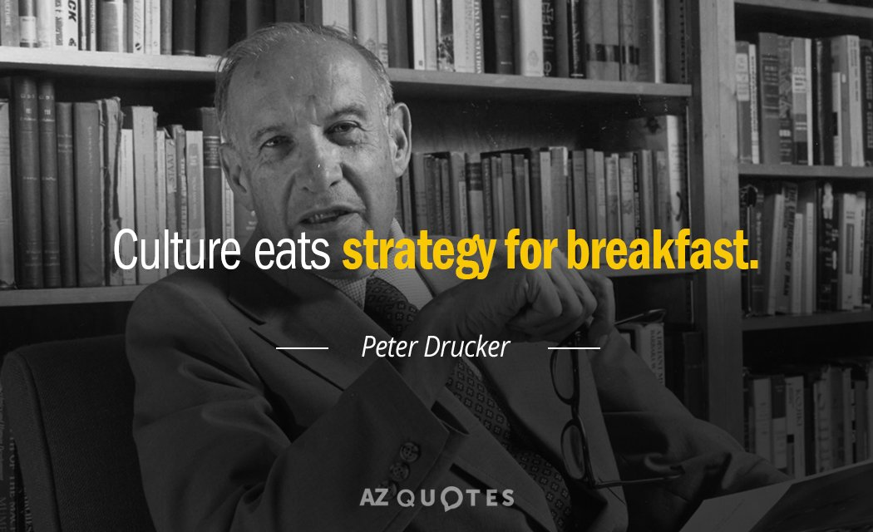

Slide 69
What is culture?
‘the shared basic assumptions that an organisation learns as it solves problems of adaptation and integration. These are considered to be ‘valid’ and are taught to new members as the correct way to perceive, think, feel or act.’ (Schein)
‘the values and beliefs that characterize organizations, as transmitted by socialization processes that newcomers have, the decisions made by management, and the stories and myths people tell and retell about their organizations’(Schneider and Barbera)
‘the interweaving of an individual into a community and the collective programming of the mind that distinguishes members … it is the values, norms, beliefs and customs that an individual holds in common with other members of a social unit or group’. (Ogbanna)
‘deeply held beliefs about success' (Bissell)

Slide 70
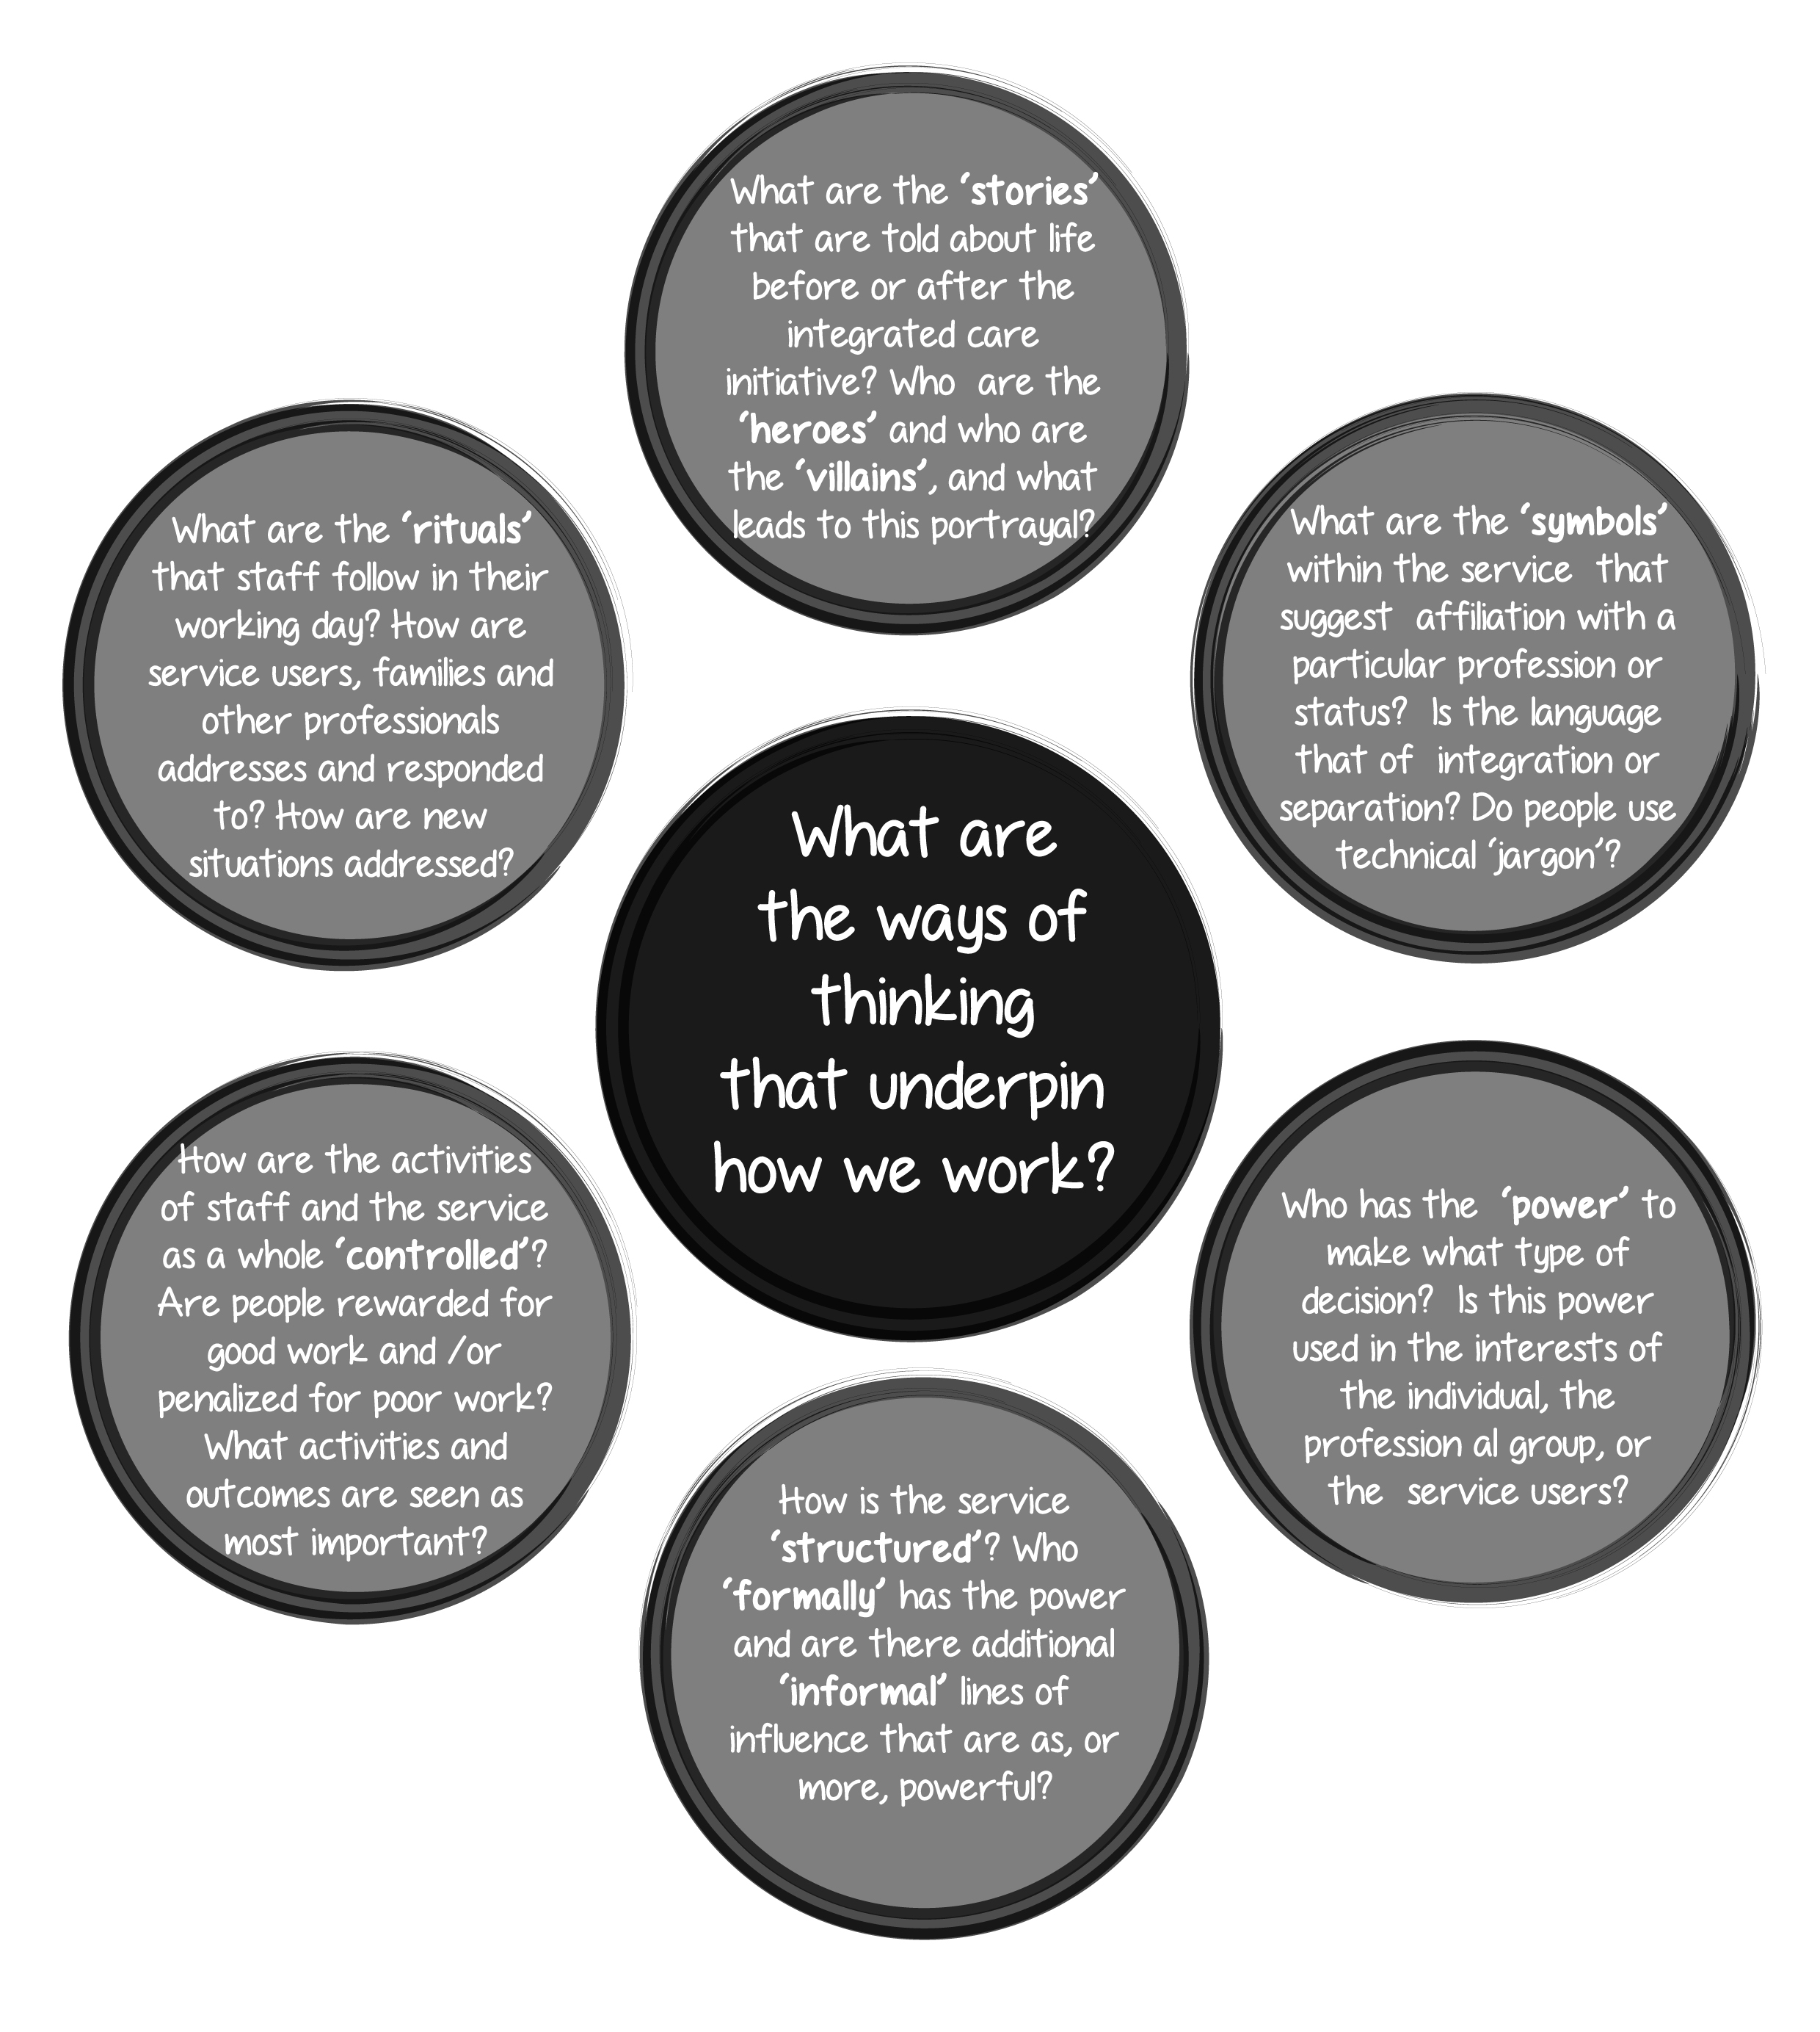
One culture in an organisation?

Slide 71
Different organisations, different professions, different cultures, different competencies:
The 4 Worlds of Care
Community
Control
Formal board
Administrative hierarchy
Professional chimneys
Operating workflow
Cure
Care
Adapted from Glouberman/Mintzberg 2001. Managing the Care of Health and the Cure of Disease—Part I: Differentiation. Health Care Management Review, 26(1):pp 56-69.

Slide 72
Sustaining culture change
Align vision and values
Make incremental change
Foster distributed leadership
Promote staff engagement
Create collaborative interpersonal relationships
Critically assess and learning from change interventions
Willis et al 2016

Slide 73
Building multi-disciplinary, inter-organisational teams

Slide 74
A short story
“A surgeon in a London hospital transplanted the livers of 10 patients. Two died, and 8 survived. One of the latter was a young woman, whose cancer of 5 years earlier had returned, while the liver of another was slowly being rejected, necessitating a second transplant. Of the remaining 6, only 3 were able to resume normal working lives. Asked about his success rate, the surgeon claimed 8 out of 10. Indeed, he was prepared to claim 9 out of 11 after the retransplant (since he counts livers, not people!). An immunologist, who felt the surgeon should not have operated on the young woman, put the rate at 7 out of 10, while an administrator put it at 6 out of 10. The nurses, most aware of the quality of the lives of those who could not return to work, put it at 3 out of 10. And the right answer? Take your pick.”
Adapted from Glouberman/Mintzberg 2001. Managing the Care of Health and the Cure of Disease—Part I: Differentiation. Health Care Management Review, 26(1):pp 56-69.

Slide 75
Network management theory
Boundary spanners
When networks cannot directly produce their intended objectives but rely on key actors in … their member organisations, it is necessary that the member organisations select as their representatives to networks [individuals as] 'boundary-spanners' with sufficiently high status, power and authority within their 'home' organisation to champion and implement network decisions. Sheaff 2011 p.214

Slide 76
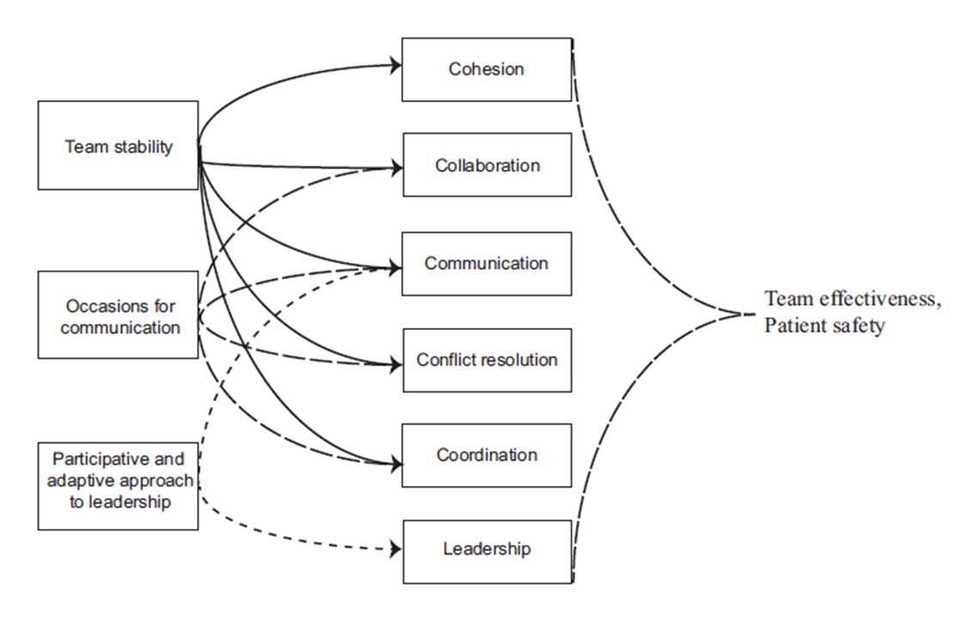
Notes:
Rydenfalt et al 2017: what are the organisational supports that can encourage team working
The climate within a team can account for 30% of a teams performance The leader has a critical influence on the team climate with up to 70% of the climate is influenced by the leadership style adopted in the team – organisational leadership is key to setting the approach that is encouraged and fostered
Performance and Innovation Unit (2000) Strengthening Leadership in the
Public Sector http://www.cabinet-office.gov.uk/innovation

Slide 77
Teamwork Dimensions
Interacting
Notes:
Research also highlights that working on the interpersonal dynamics is also helpful (ewan et al 2017)

Slide 78
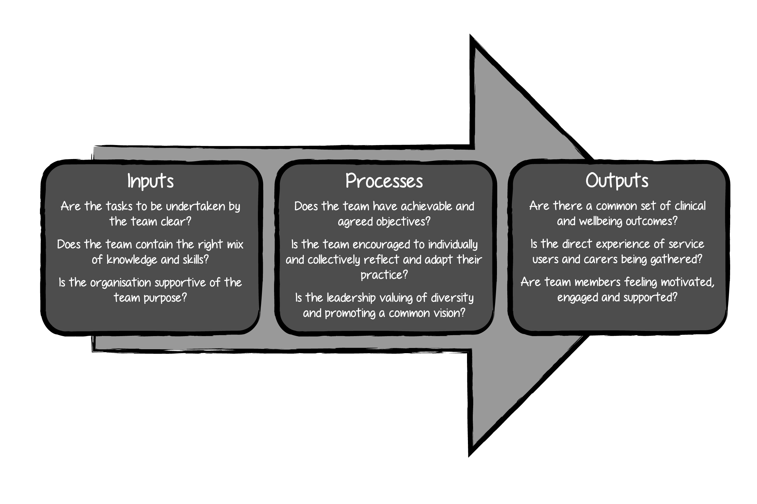
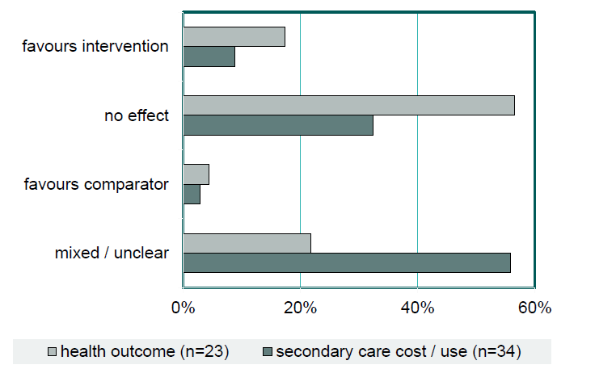
Mason et al 2014
Jelphs et al 2016
Notes:
The elements of a well functioning team are summarised in this graphic – discuss on your tables the extent to which these are reflected in your local teams.

Slide 79
Establishing multi-displinary teams
Notes:
Example of team development process – GPs and Social workers

Slide 80
“This “c factor” (the group’s collective intelligence) is not strongly correlated with the average or maximum individual intelligence of group members but is correlated with the average social sensitivity of group members, the equality in distribution of conversational turn-taking, and the proportion of females in the group.”
(Williams Woolley, Chabris, Pentland, et al. Science 2001)

Slide 81
Evidence for team (based) working
Reduced hospitalisation and costs
Reduced medical error
Increased effectiveness and innovation
Improved patient / service user satisfaction
Greater implementation of innovations
Lower patient mortality
Increased mental well-being of team members
Reduced turnover and sickness absence
More effective use of resources
Improved patient satisfaction
West and Lyubovnokova 2013
Notes:
Research has been conducted at Aston Business School for past 10 years on what makes teams effective in health care organisations.

Slide 82
Notes:
Highlight the dramatic rise in time spent in mdts in cancer care

Slide 83
Danger of Pseudo teams
(West 2013)

Slide 84
Real Teams (and pseudo ones…)

Slide 85
Avoiding pseudo-teams through..
Diversity of professions within a team provides greater experience and skills which can result in more holistic and creative responses to the needs of patients and service users.
Perceived equality in status and power between team members.
Leadership and co-ordination are essential for communication and cooperation within a team and in developing positive relationships with external teams.
Clear objectives provide a vision of what success will look like and for team members to understand their individual contribution
Patients and service users are not commonly engaged in team working but where this has been achieved there are benefits for all concerned.
Supportive physical, technological, organisational and policy context in which an inter-professional team operates
Jelphs et al 2016

Slide 86
Leading and managing alliances

Slide 87
Leaders for quality cultures:
Collective leadership
An inspiring vision and compelling strategic narrative
Clear priorities and objectives at every level from Board to front line
Have supportive people in leadership and management roles
Have high levels of staff engagement
Learning and innovation is seen as everyone’s responsibility
Have high levels of genuine team working and co-operation across boundaries
  ‘Leadership of all, by all, for all’
West et al 2014
Notes:
Health care systems globally need leadership of the highest calibre to respond to financial and service pressures and expectations. Returning to earlier themes – the Kings Fund in the UK has argued that we need to move away from heroic leaders – to see leadership as something that is hard and distributed across organisations. To be successful we will also have to work with others in new ways and create new partnerships and ways of working. The Kings Fund and others are describing this style of leadership as Collective leadership – whereby everyone takes responsibility for the success of the organisation, not just their own job or area of work – this moves away from developing individual capability of leaders to something where a collective capability is paramount .
In this way of working leaders need to ensure that all staff adopt leadership roles and take individual and collective responsibility for delivering safe, effective high quality career and compassionate care for patients. Attention to culture will be key – and the most important determinant of an organisations culture is leadership – As Robert Francis said at the Mid Staffs Inquiry – “Leaders get the cultures they create”.
In this slide we can see some of the specific behaviours and approaches needed .
What is striking for our session here ….. Is just how far removed this approach is from the initial theories and approaches explored earlier . As we respond to a changing world and expectation .. We are moving our thinking from individual heroes to a collective, shared responsibility responsibility ( in other word real team based working.)

Slide 88
How to be a successful team leader
67 per cent of the variance in team members' trust towards leaders depended on 3 factors, namely:
consulting team members when making decisions,
communicating a collective vision, and
sharing common values with the leader.
Trust in the leader was also strongly associated with the leader's effectiveness.
(Nicole A. Gillespie, Leon Mann, (2004) "Transformational leadership and shared values: the building blocks of trust", Journal of Managerial Psychology, Vol. 19 Issue: 6, pp.588-607)

Slide 89
Notes:
Evans et al 2016: learning from toronto

Slide 90
Network management theory – incentives*
Prudent reciprocity | Maintain good social relations
Financial | Tangible resource benefit
Shared values | Moral incentive with others
Technical persuasion | Evidence feedback of what works
Governmentality | Transparency – monitoring – peer pressure
Contracts | Enforce
… the ‘glue’ in these networks was not shared ‘values’ but shared activity, that of producing network artefacts … even when members had no shared view of the rationale or goals of the network … evidence basing created normative agreement about how the network’s core processes should be undertaken.
Sheaff et al 2010
… collaboration is too complex and idiosyncratic for … prescriptive remedies. It therefore focuses on providing ‘handles for reflective practice’ … which expect the user to formulate the managerial action in light of their own circumstances and competencies.
Hibbert et al 2008
* Sheaff, R., Schofield, J., Charles, N., Benson, L., Mannion, R. and Reeves, D. (2011)
The management and effectiveness of professional and clinical networks. Final Report.
UK National Institute for Health Research Service Delivery and Organisation Programme.
Notes:
Sheaff et al (2011) describe a range of incentives that that a manager can use to fulfil these tasks, the one I want to focus on is technical persuasion.
Technical persuasion – logic of making decisions based on the evidence of what works.
This is because it can surmount differences in member values and approaches – QUOTE 1
And, second it fits with this notion of participatory evaluation being a generalisable network development strategy – QUOTE 2
Dealing with conflict & commitment & using technical persuasion involves monitoring
what the network is
what it does &
for what benefit
and then feeding this back to network members – who can consider this in their local context.
Networks are to varying degrees, self-regulating – hence self-knowledge important for network evaluation

Slide 91
Network theory - management tasks
… many of the dynamics of the collaborative processes are recursive. They do not get established at one time to be forgotten. Instead purpose, membership, trust, power, leadership, and identity all must be negotiated and managed continuously throughout the collaborative process. Sandfort & Milward 2008 p. 154-5.

Slide 92
In summary

Slide 93
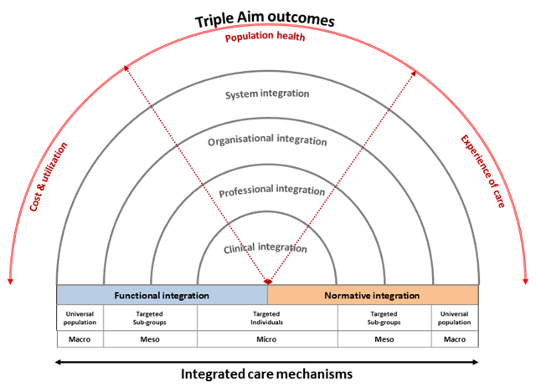
Alliances
Notes:
MDTs situated in the inner circles of clinical and professional integration – but need to be supported by wider organisational and systemic context

Slide 94
System wide focus
VISION: To integrate the care of patients, particularly those at risk of poor health outcomes, across the health system in order to improve patient and provider experience, health outcome and efficiency.
Stakeholders – how do we meet community need?
Joint planning
Community & patient engagement
Process perspective- what do we need to excel at?
3. ICT to share information
4. Shared clinical priorities agreed
5. Data available as measurement tool for QI
What do we need to achieve to ensure sustainability?
Focus of care on geographical population
Incentives for support care coordination
Learning, growth & change – people and culture
8. Appropriately train workforce with acceptance of values of working together
9. Culture of system innovation
10. Change supported and collaborative
VALUES: ‘Right care, right place, right time’
© Nicholson et al 2015

Slide 95
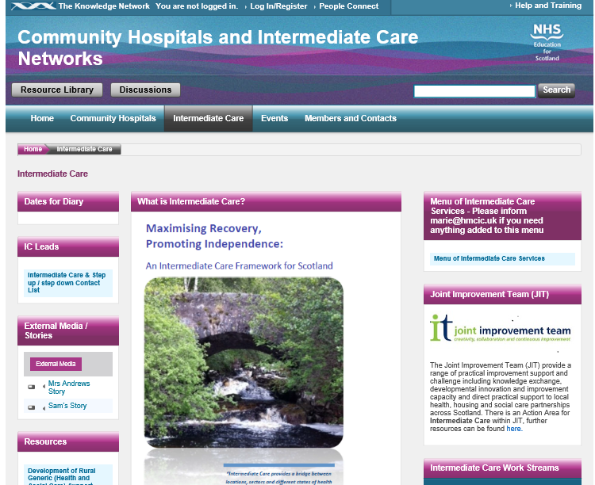
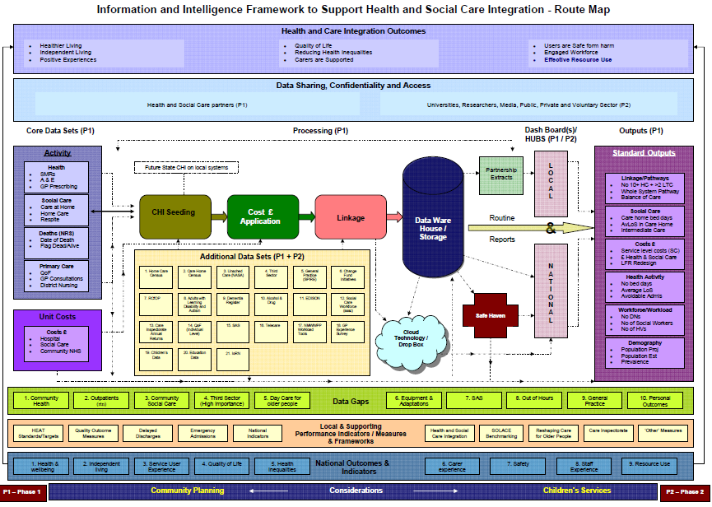
Success through shared aims, shared learning and shared measures
Common Minimum Dataset - six sections:
  Demographics
  Referral
  Home Care
  Intervention
  Discharge
  Additional Referrals - within intermediate care
Full dataset document and more information can be found at: http://www.knowledge.scot.nhs.uk/chin/intermediate-care.aspx

Slide 96

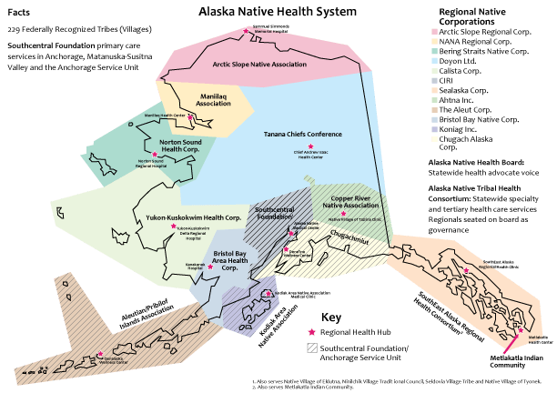
Training in the
Nuka Health System, Alaska
Development Centre with 11 Departments of Learning
Mandatory annual CPD programme for everyone
RAISE programme
Community engagement and patient education programmes
“The soft skills are the hard skills.”

Slide 97
The Implementation Model for
Integrated Care
Change Management Steps
Relationship Building Activities
Needs Assessment
Establishing a guiding coalition
Situational Analysis
Building support for change
Value Case Development
Vison and mission statement
Time
Feedback Loop
Cycle of Learning
Strategic plan
Establishing mutual gain
Developing collaborative
capacity
Communication
Implementation and
institutionalisation
Monitoring and
evaluation
Goodwin, 2015, 2017; Lewis and Goodwin, 2017

Slide 98


Culture of a Learning Healthcare System Builds Value
Common Vision
Clinical Work Processes
Data and Evaluation Transparency

Slide 99
In Summary
“I can plan my care with people who work together to understand me and my carer(s), allow me control, and bring together services to achieve the outcomes important to me.”
National Voices 2013
K. Viktoria Stein, PhD
Head of the Integrated Care Academy©
International Foundation for Integrated Care
viktoriastein@integratedcarefoundation.org
www.integratedcarefoundation.org

Slide 100


Slide 102

  A Local Partnership to achieve System Change
  Catherine Turner - Executive Manager, Commissioning- HNECC PHN (Monday 5 November – Byron Bay)
  Jane Gray - Executive Director, Partnerships Innovation and Research – HNELHD (Wednesday 7 November – Coffs Harbour)

Slide 103


We acknowledge the traditional custodians of this land and pay our respects to Elders past, present and future.

Slide 104
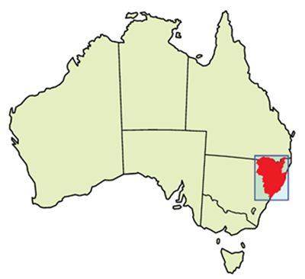
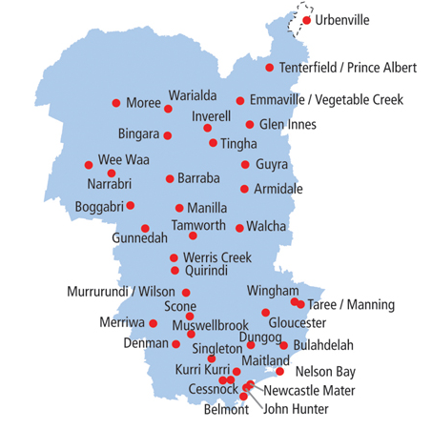
The community we serve
920,370 people, including
52,990 Aboriginal and Torres Strait Islander people
169,846 residents who were born overseas
These people live in metropolitan area, several large regional centre and many smaller rural centres and remote communities
Notes:
We are talking about our experience working in a large geographic areas spanning one whole Local Health District and about two-thirds of a Primary Health Network.
This area has
Over 920,000 people, including nearly 53,000 Aboriginal and Torres Strait Islander people
Around 170,000 residents who were born overseas
a major metropolitan area, several large regional centre and many smaller rural centres and remote communities within its borders.
While there are some unique characteristics in our area and communities, we are probably not terribly different from you, and will have much more in common with you and your areas and communities. We hope that our presentation will give you ideas that are helpful for your situation.

Slide 105
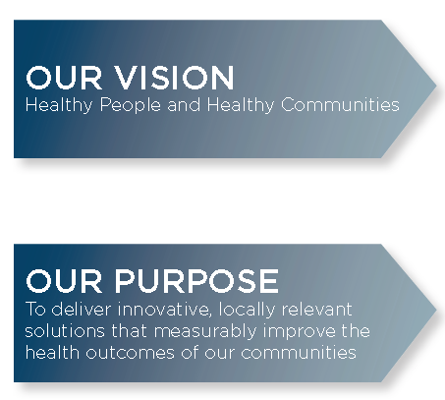
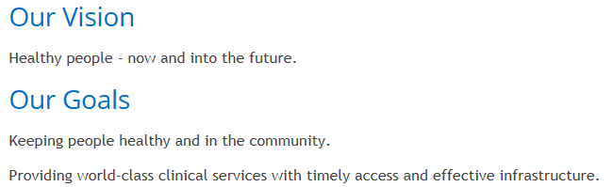
Our organisations are responsible for the same population.
We can’t achieve our vision without each other…..
Local Health District
Primary Health Network

Slide 106
…Or other partners in our local health ecosystem
Notes:
We can’t accomplish our vision and strategic priorities without partnerships with these organisations too.
Our health ecosystem.
Over the last 5-6 years, we have been working in various ways trying to establish the most effective Alliance model for our region, considering formal agreements with many of these services, however, we have settled now on the partnership between HNELHD and HNECC PHN.

Slide 107
We acknowledge the limits of our reach
We work within Commonwealth laws, policies, guidelines and environment
We can’t change things that are the responsibility of the Commonwealth and NSW Governments
We must meet our service agreement commitments with our funders
Within this, how can we work collaboratively so that our $2.2 billion in LHD funds and PHN purchasing power and Primary Care Support role will help our health system meet the needs of our communities at the highest quality and lowest cost, and provide a great place to work for our staff and volunteers

Slide 108
We are inspired and supported by
Canterbury Initiative, New Zealand
International Foundation for Integrated Care
Swedish Health Care System
NHS Scotland
AIM Methodology
NSW Health Planning and Innovation Fund
Collective Impact Forum
Notes:
We have been studying, revieiwing and working with a number of frameworks over the years, developing our own version of effective alliancing. This paper will outline what we have decided are the key elements of an effective alliance and some examples of how we are making a difference, together, for our local communities.

Slide 109
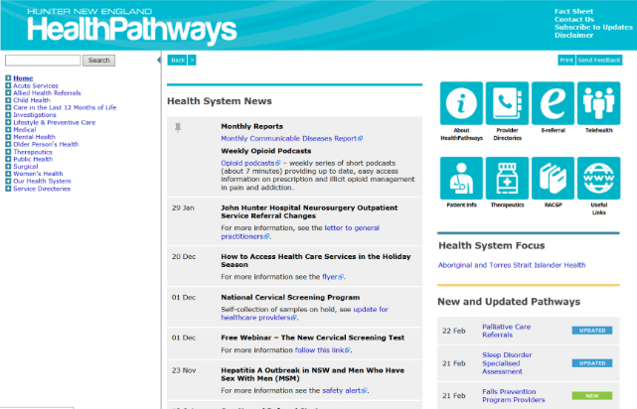

Past local initiatives have taught us how we can act like “one system”
1990s – DocFAX – hospital discharge summaries faxed to GPs
1999 - – GP Access After Hours to provide urgent-care alternatives to Emergency Departments
2010 – Aged Care Emergency Services to help Residential Aged Care Residents stay in place
2012 - HealthPathways
2014-2017 Hunter Alliance

Slide 110

Nine Principles of Effective Alliancing
A formal agreement to partner.
An agreed way of prioritising and planning integrated care work together in an annual cycle.
Transparently holding ourselves accountable through a regular Integrated Care Alliance Executive meeting.
Agreed ways of using existing vehicles for involving clinicians
Agreed ways of using existing vehicles for involving patients and families
Agreed ways of sharing knowledge about “how we do things around here” with our entire clinical community.
Commitment to sharing data and using Patient Reported Outcome Measures (PROMS) to measure results from patient perspective
Clear programs for supporting aspiring change agents whose work meets our priorities:
Shared commitment to research and its
  translation

Slide 112
Workstreams
Mental Health Service Integration | Data Enablers
Drug and Alcohol Service Integration | Integrated Care Enablers
First 2000 Days of Life Service Integration | GP VMO Workforce Planning Place Based Approach
Palliative and End of Life Care Service Integration | ​Participate in NSW Regional Health Partners Centre for Innovation in Regional Health
Chronic Disease Service Integration
Urgent Care
Closing the Gap Service Integration
Notes:
The workstreams all have shared Exec Sponsorship and allocated operational team members from both organisations. Later, we will provide an example of the work being conducted in one of the workstreams.

Slide 113
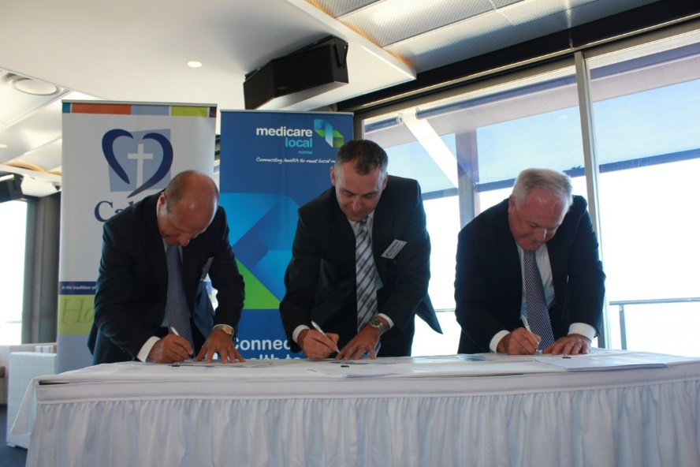
1. A formal agreement to partner.
Memorandum of Understanding
A number of Service Level Agreements
Operational Plan
Notes:
Over time, we have identified what we believe to be the 9 Key Principles of Effective Alliancing. This is based on evidence in the literature, learning from other Alliances and our experience in local alliancing between health partners. These are the HNE version and we use them to guide our teams.
The development of the documents and the processes that they outline takes significant time, but the planning up front is now accelerating the outputs of the teams. The documents are our formal contracts to one another and lay out the way in which we work together, our reason for being and provide decision making assistance for our teams.

Slide 114
2. An agreed way of prioritising and planning integrated care work together in an annual cycle.
Integrated Care initiatives are identified, planned and monitored by agreed leaders – using Sponsorship framework from Accelerated Implementation Methodology
Partnered activities could change annually

Slide 115
3. Transparently holding ourselves accountable through a regular Integrated Care Alliance Executive meeting.
Co Chaired Executive Meetings
Exec Sponsors bring achievements and challenges to the shared executive for consideration
Notes:
We use language that has moved from asking permission for relevant team members to work together, to being required to work together on shared initiatives. A limited number are monitored via this meeting and the formal structures, but many other activities are blossoming through enhanced collaboration.

Slide 116
4. Agreed ways of using existing vehicles for involving clinicians
Existing Clinical Councils
Existing Clinical Networks and Streams
Connecting Clinical Expertise to fill gaps
Where required, employ GP Clinical Advisors
Notes:
The existing Clinical Councils in both organisations provide the Advice that is required to the workstreams when undertaking new work, spreading the implementation of existing work, or seeking to improve current services. Previous Alliances had employed clinical experts, but by using the existing positions and structures, the responsibilities for working in an integrated way are included in the daily responsibilities, rather than being seen as an add on.
Where clinical expertise has not been obviously available, we have been able to call on the existing LHD networks to nominate Clinical Leaders to be part of the workstreams. Inclusion of GP Clinical Advice, however, is often purchased. The PHN employs GP Clinical Editors for Health Pathways, but otherwise brings in GP Clinical Advice on a program or project basis, enabling us to utilize clinicians from a range of settings. This could include those in metro or rural areas, sole practitioners or ones who are part of large multidisciplinary practices, long standing local practices, or those from large Corporates. This allows a diversity of view which strengthens the work.

Slide 117
5. Agreed ways of using existing vehicles for involving patients and families
Existing Community and Consumer Advisory Committees
Existing Consumer Advocacy groups
Consumer Representation on some of the workstreams
Notes:
This has been challenging in some of the workstreams, but we are committed to including the voice of the patient in all of our work. This has included having consumers sit on the workstream leadership teams, having patients and families involved in co design and using the existing structures to design the work and spread the news about new or improved services.

Slide 118
6. Agreed ways of sharing knowledge about “how we do things around here” with our entire clinical community.
Telling our stories
Consistent management of workstreams
Helps us reduce variation in clinical practice

Slide 119
7. Commitment to sharing data and using Patient Reported Measures (PRMS) to measure results from patient perspective
Joined up teams can share data for integrated projects
Shared evaluation strategies
Testing a number of PREMs and PROMs and data collection systems

Slide 120
8. Clear programs for supporting aspiring change agents whose work meets our priorities
Capability building for our team members
Teams can bring their aspirations to the Shared Executive
Transparent means for identifying priorities and services which will receive support under the strategy

Slide 121
9. Shared commitment to research and its translation
Participation in NSW Regional Health Partners Centre for Innovation in Regional Health
Access to research and evaluation support
Focus on Translation of research into practice across the care continuum

Slide 122
Case Study – HNE Integrated Diabetes Model of Care – Chronic Disease Service Integration
“Make Hunter New England the best place in Australia for those who live with Diabetes”
Trevor
(consumer representative)

Slide 123
HNE Integrated Diabetes Model of Care

Slide 124
HNE Integrated Diabetes Model of Care
Results to date
80 enrolled practices that have hosted a clinic
190 Clinics have been held
1483 Patients have been seen in the Clinic
307 GPs have participated in the program
96% of practices have achieved improved rates of HbA1c screening
100% of practices have improved rates of Kidney screening
100% of practices with improved rates of patients meeting HbA1c target of <7%
100% of practices have improved rates of patients meeting Cholesterol targets

Slide 125
Agreed elements of Joint Commissioning are reflected in our new Alliance
Shared Governance
Shared Data, Analytics and System Measurement
Shared Needs Assessment and Service Design
Co-investment
Shared Performance Monitoring, Management and Evaluation
Notes:
Not sure about this one. It could be confusing, but as there will be a number of PHN people there, it could be good to bring this back in at this stage. I thought we could talk about how we decide how to invest in the sustainability of the program?

Slide 126

Working together with the patient at the centre of their own care
Notes:
I’ve inserted the Hyperlink to the You Tube video in the photo. It is 4.28 long, but really tells the story better than I can.

Slide 127
Final Messages
Integrated Care through Alliancing is possible when there is a shared benefit
Clinical and Executive Leadership is crucial
Lack of joined up funding is NOT a barrier to joined up care
Notes:
I think there are good messages, but I have run out of steam

Slide 129

Transformers III
Alliance Contracting
November 2018

Slide 130
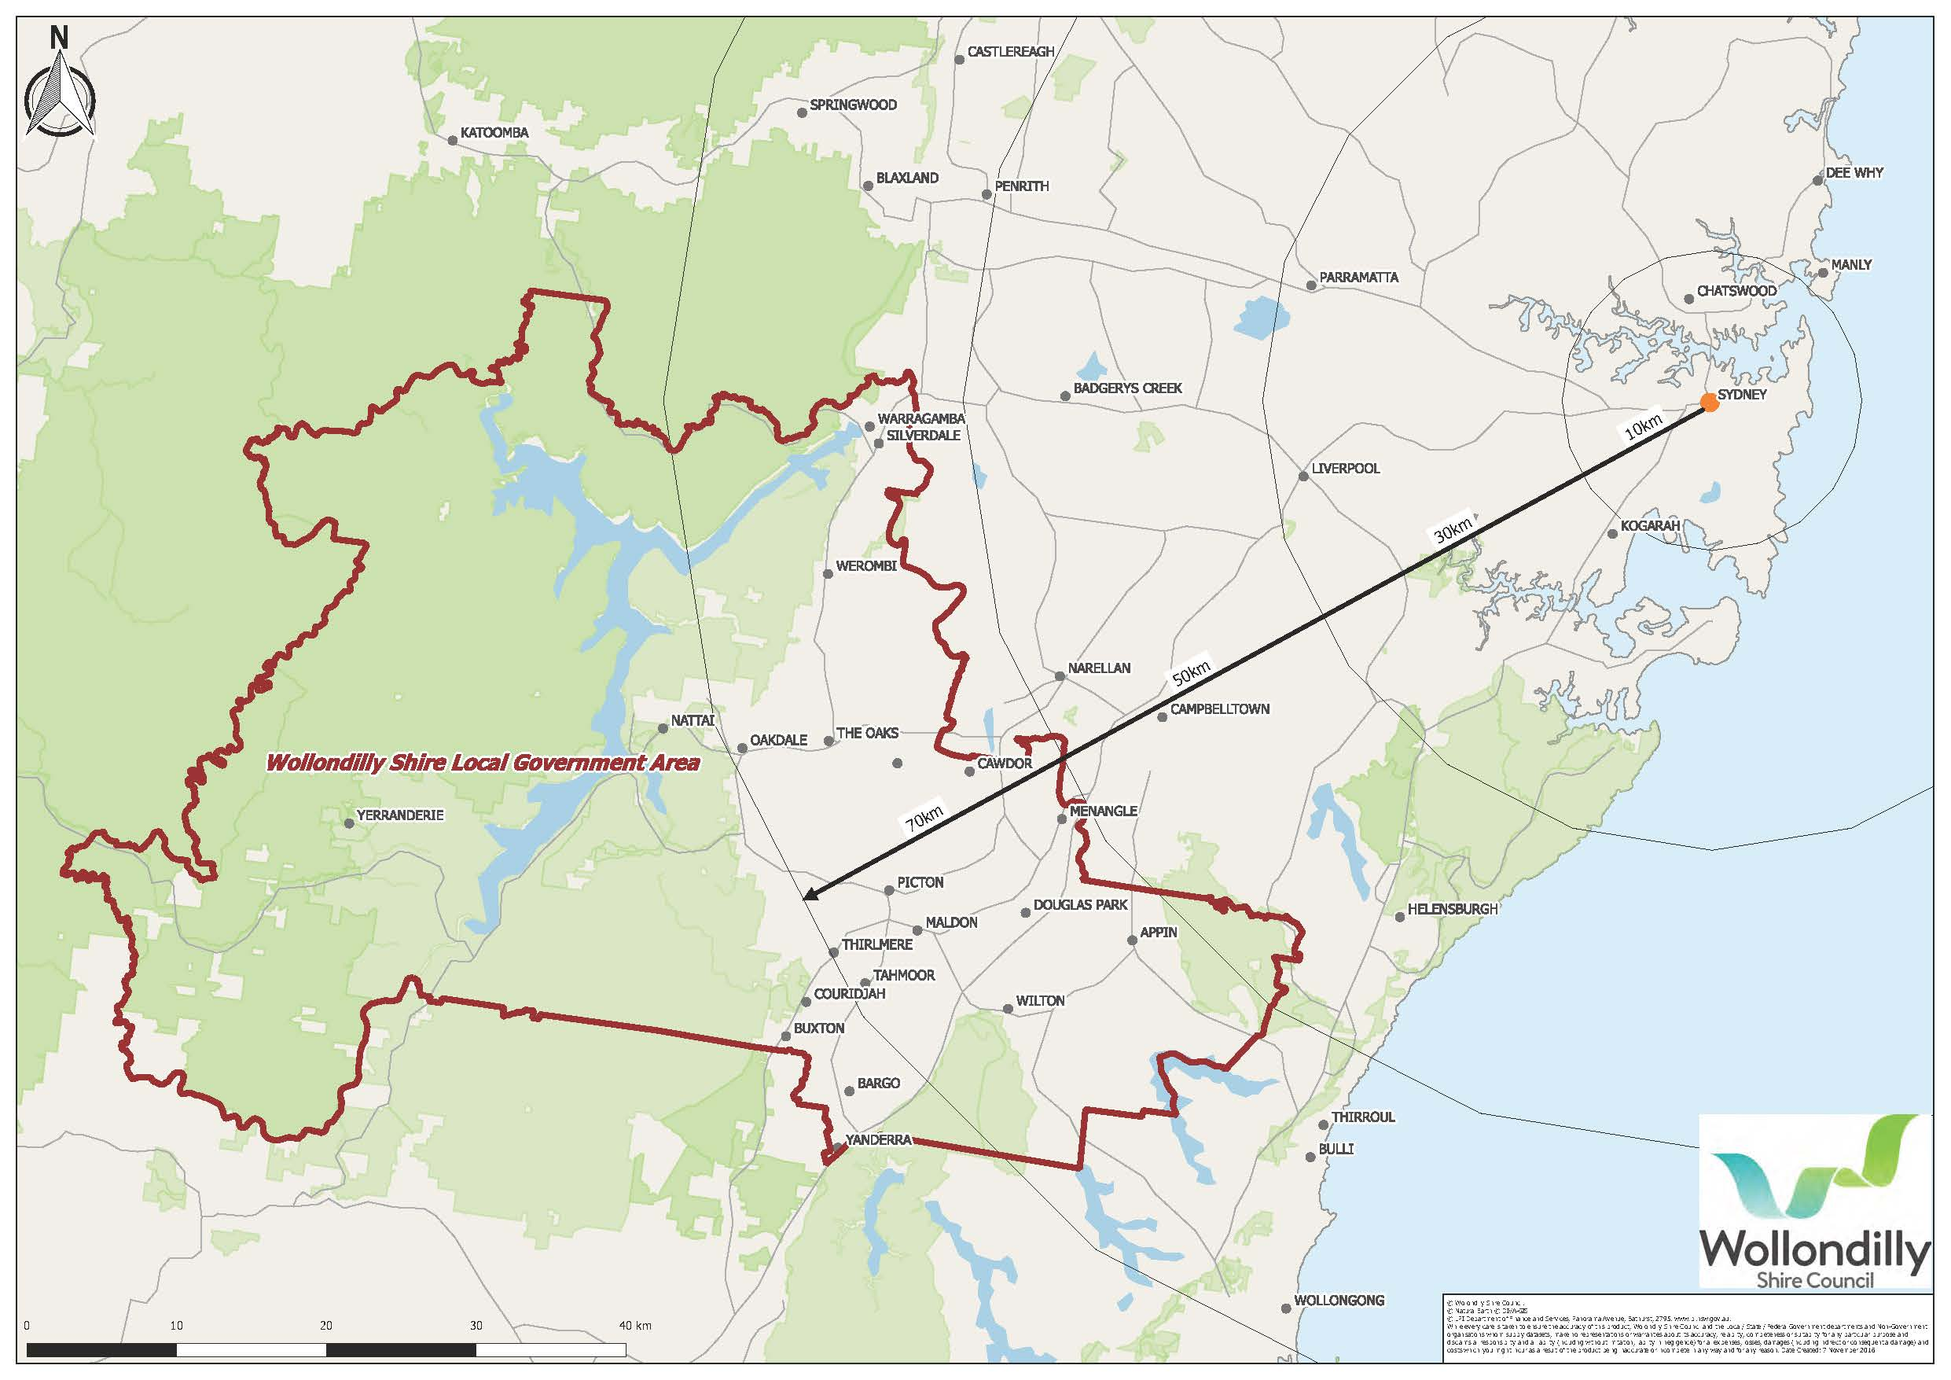
Wollondilly (Location)
Notes:
Location: south western fringes of the Sydney metropolitan area
Land area of 2,561 square kilometres
Consists of 19 towns & villages
No hospital/acute care centre (public or private)
Lowest ratio of GP to resident population in NSW (1 GP: 2750 people)
Very limited access to specialists
3 RACFs (< Government benchmark)
19 Allied Health Private Providers
10 locally based NGOs
Several Government Service Providers
- One Community Health Centre
- Wollondilly Shire Council
- South West Community Transport
- SWSML allied health services (diabetes and mental health)

Slide 131
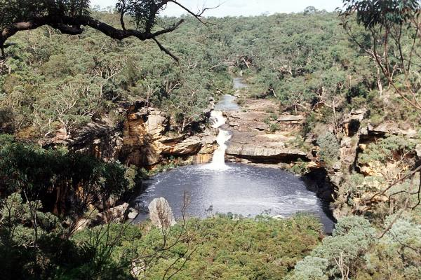


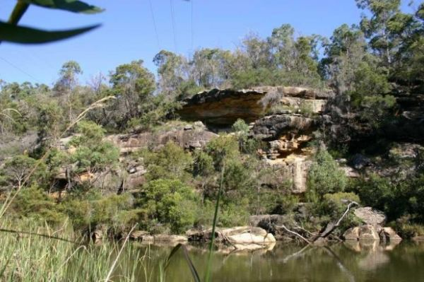
Mermaid Pools
Bents Basin
Little River
Burragorang

Slide 132
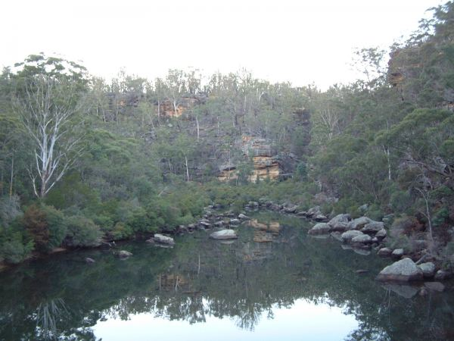



Broughton Pass
Yerrandrie
Broughton Pass
Thirlmere Lakes
Platypus

Slide 133


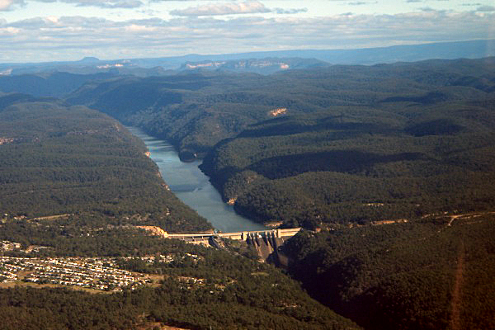

Cataract Dam
Nepean Dam
Warragamba Dam
Avon Dam

Slide 134
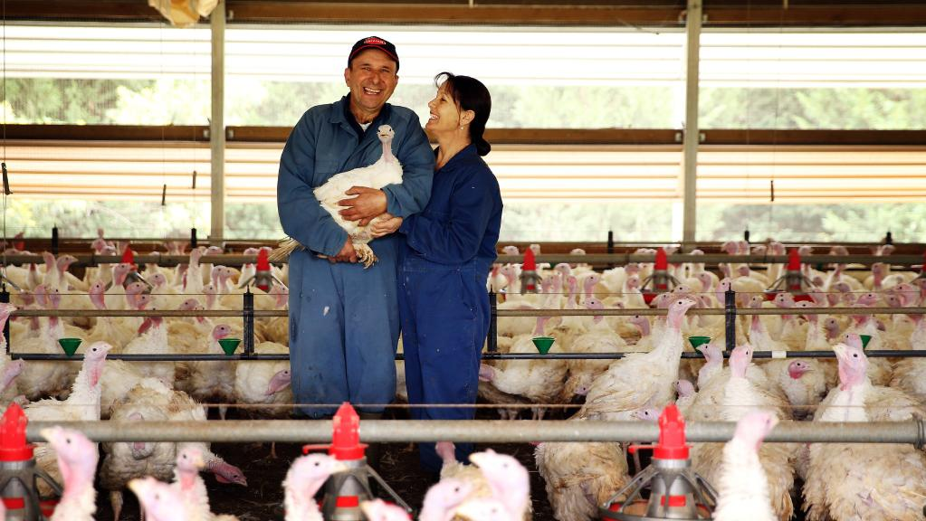

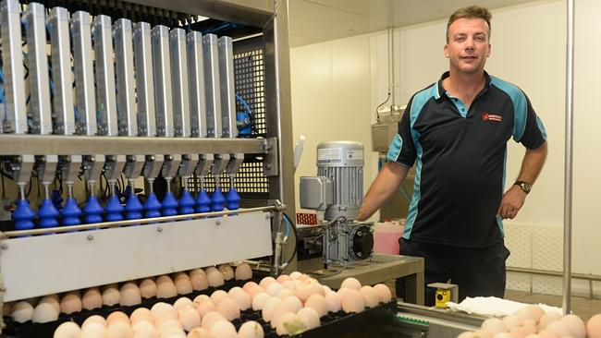



Vegetables
Poultry Farmers
Eggs
Flowers
Orchards
Hatchery

Slide 135

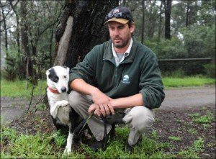


Dodge
The Wolverine
Rural Living
Aboriginal History

Slide 136

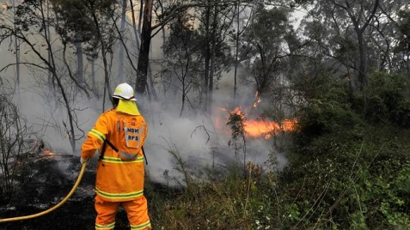
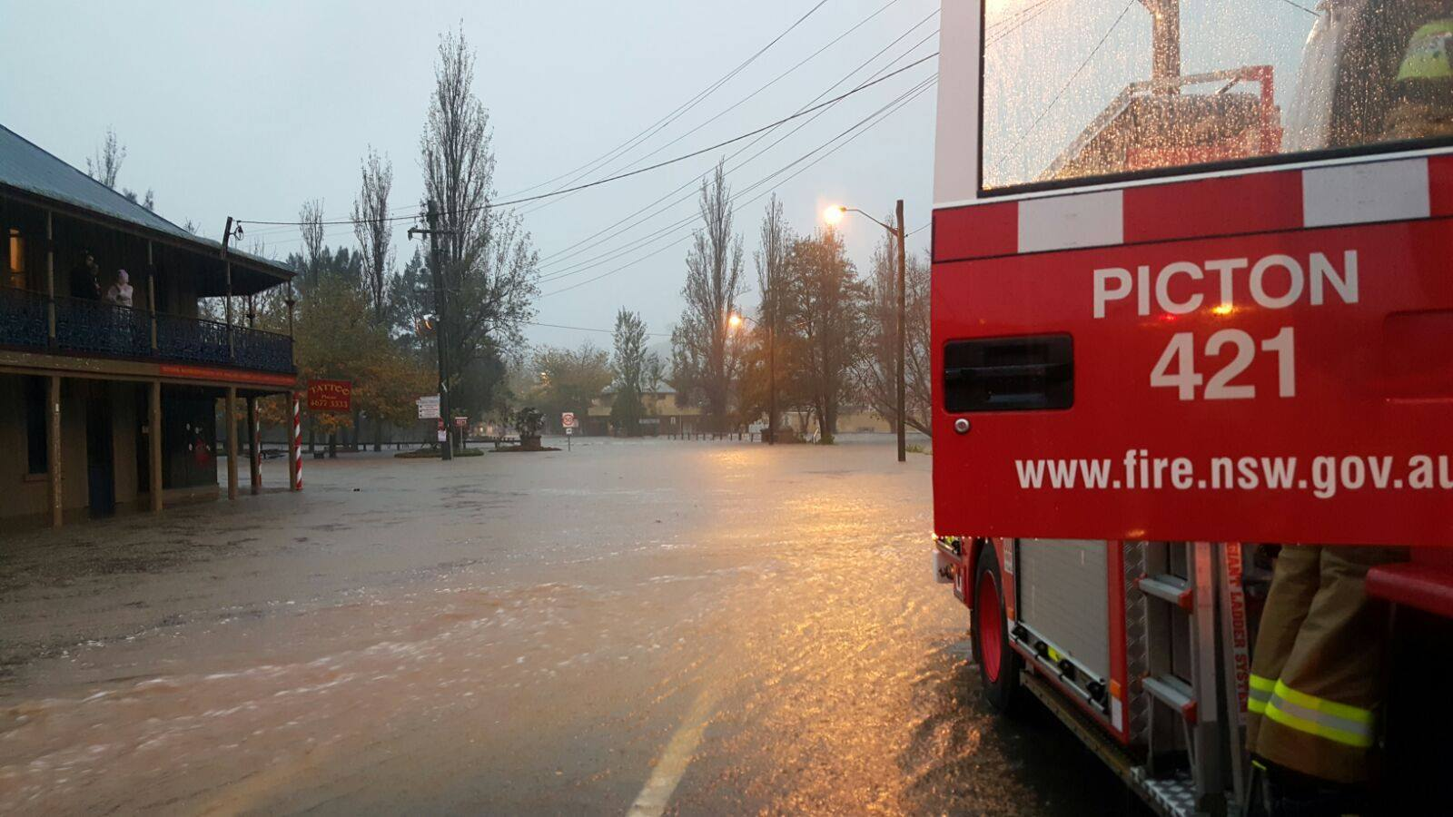

Slide 137
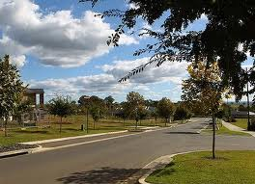
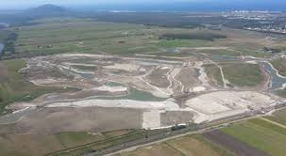
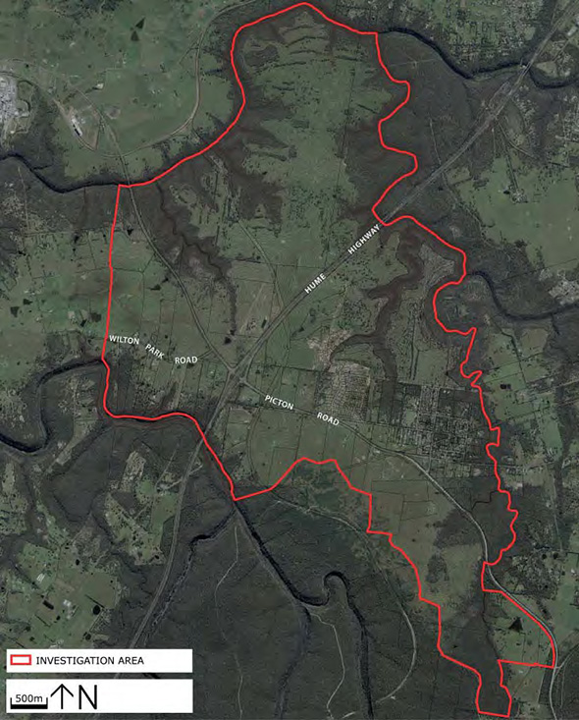
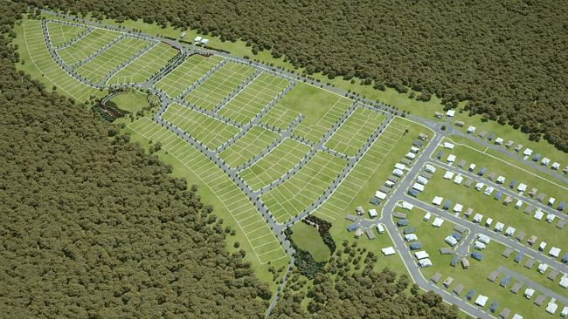
Bingara Gorge
Appin Valley
Wilton Junction

Slide 138




Wollondilly (Demographics)
=24,000
=24,000
Total = 48,000
72,000
48,000
Notes:
Estimated resident population = 48,000 people (24,000 female and 24,000 male). Of this, approx. 2.4% are Aboriginal and Torres Strait Islander (500 female & 500 male)
17.2 people per square kilometre
Note: dispersed townships with none having a population greater than 5,000
Expected growth of approx. 24,000 people by 2036
Younger population with highest growth in aged (112% increase for persons aged 65+)
Note population growth does not consider potential growth with Wilton Junction
Only 36% finish year 12
Over 58% of working residents travel outside Wollondilly to work
91.2% English speaking
51% complete Year 10; 36% complete year 12

Slide 139
Wollondilly (Health Status)
GP Usage
Hospital Usage
Overweight/Obese
Alcohol consumption
Smoking during pregnancy
Coronary heart disease
Lung cancer
Intentional self-harm
Notes:
Higher rates of GP and ED usage
Lower rates of outpatient clinic usage
Higher rates of people reporting they are overweight or obese - 2nd highest rate of obesity in SWS
Lower levels of adequate physical activity and fruit consumption
Higher levels of alcohol consumption at harmful levels and rates of smoking during pregnancy
Higher rates of coronary heart disease
Higher rates of lung cancer
Higher rates of intentional self-harm

Slide 140
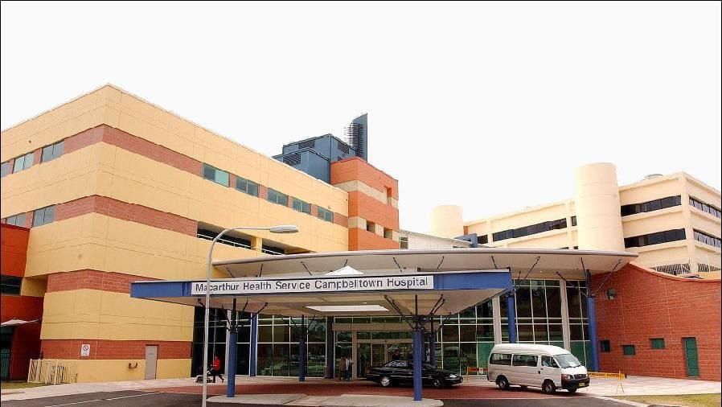
The Need for a Solution
Notes:
Image of Campbelltown Hospital
Wollondilly residents were over using Campbelltown, Camden and Bowral hospitals
Wollondilly is the only hospital in the 7 LGAs in SWS without a Hospital
It stemmed from the Council advocating for outreach and acute services in Wollondilly - Wilton due to the 50,000 people expected to move there in the next 30 years (the size of Port Macquarie)
A partnership was formed between the Council, South Western Sydney Local Health District and South Western Sydney PHN to address issues and implement new innovative ways to do things better for the Wollondilly community

Slide 141
The Wollondilly Health Alliance
The Wollondilly Health Alliance (WHA), formed in 2014, is an initiative of the NSW Health Integrated Care Strategy.
The vision for the WHA is a community that:
Is healthier
Finds it easier and quicker to access services
Has access to the highest quality of health services
Has a say in the development and provision of health services that affect them
Notes:
What is the Alliance? As the name alludes, it is an alliance in Wollondilly that focuses on health and wellbeing

Slide 142



The Wollondilly Health Alliance
“We believe in coming together for the benefit of our community’s health and wellbeing”
In addition to the three key member agencies, General Practitioners, Non-Government Organisations and Private Enterprise Organisations are considered to be the core customers of the Alliance.
Notes:
“We believe in coming together for the benefit of our community’s health and wellbeing”
Partnership has been key to our success
GPs, 3 x NGOs
Roles & Responsibilities of partners
Executive representation
Working groups/sub-working groups
Project partnership/involvement
Connecting WHA to key customers
Marketing/community engagement

Slide 143
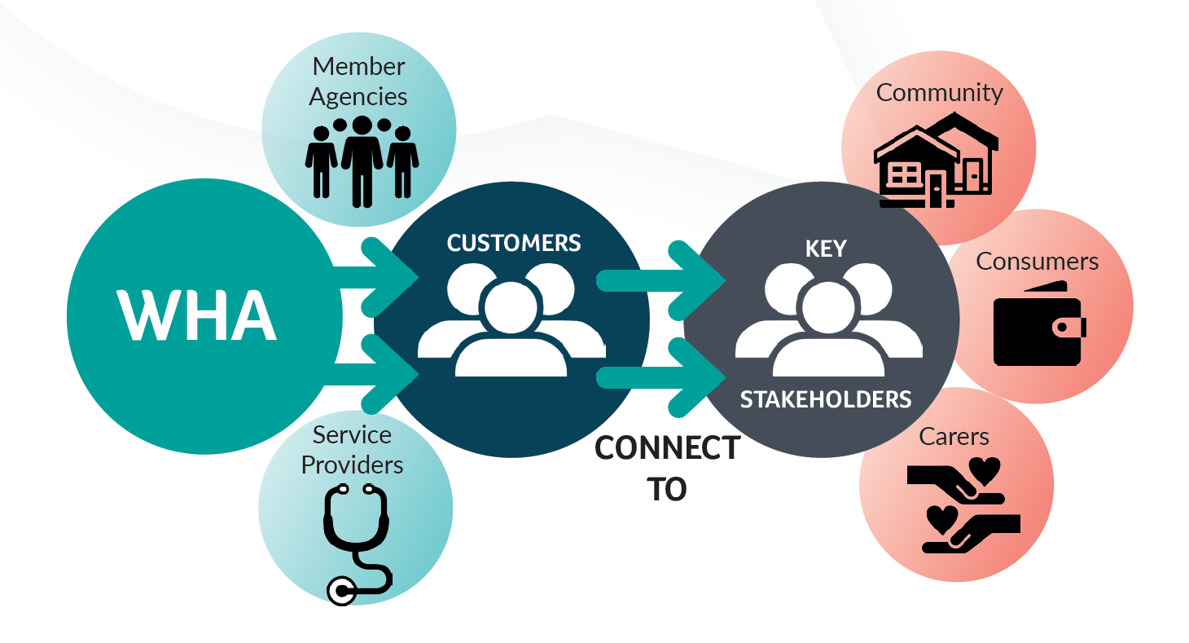
Purpose
To identify and address health care access issues in Wollondilly
  Support
  Connect
  Innovation
  Insight
  Wellbeing
Notes:
Supporting agencies and service providers to improve and maintain Wollondilly’s health and wellbeing
Connecting service providers with the community members who need them
Developing new and innovative ways to improve access to services in the area
Providing insights and information about how to service, improve and deliver a healthier Wollondilly community
Facilitating health and wellbeing through sustainable partnerships that are active, collaborative and supportive

Slide 144
Governance Framework
South Western Sydney Integrated Care Collaboration (SWSICC)
Organisation Governance (Boards and Councillors)
Alliance Executive Committee (meet bi-monthly)
Organisation Community Advisory Committees
Alliance Operational Committee
(meet bi-monthly)
Care Process Working Group (meet monthly)
Health Promotion Working Group (meet monthly)
Health in Planning Working Group (meet bi-monthly)

Slide 145
Care Process Key Initiatives
Key Initiative | Outline
Telemonitoring | Monitoring chronic disease patients’ vital signs and health conditions from their home through an integrated care platform solution; triaged via nurses, the GP and SWSLHD Triple I Hub.
Video consultation | Linking Wollondilly Community Health Centre and General practices with SWSLHD services using video conferencing.
Secure Messaging Delivery (SMD) | Increasing uptake and routine use of SMD across Wollondilly primary care providers and private specialists.
Diabetes Project | Diabetes integrated care program with a population approach. It consists of two key aspects: diabetes prevention and complex diabetes prevention.
PROMPT-Care | Pilot project to improve electronic capture of patient reported outcomes.

Slide 146
Health Promotion Key Initiatives
Key Initiative | Outline
Dilly Wanderer | Free mobile community and health information vehicle that attends community events, hosts workshops/educational sessions, regular kiosk locations and leads Heart Foundation walking and exercise groups.
Mental Wellbeing | Applying a SWSLHD wellbeing strategy to the Wollondilly Community using the Five Ways to Wellbeing as the core framework.
Social Plan | A document that contains policies and actions for achieving better outcomes across a range of factors that determine/influence health.
Healthy Towns | A community development initiative that aims to increase physical activity; build healthy workplaces; promote access to healthy and affordable food; and enhance wellbeing in the Aboriginal community.

Slide 147
Integrating Health Considerations into Council Planning Process
Partnership to identify ways of integrating health considerations into Council’s policy and planning processes.
Began with a Health Impact Assessment Learning by ‘Doing Training’ → completion of an HIA on Wilton.
Joint Planning and Health Forum was held and a joint working group has been formed.
Established a joint staff position with SWSLHD & Wollondilly Shire Council
Notes:
WSC, SWSLHD Population Health team and CHETRE have been working together to identify ways of integrating health considerations into Council’s policy and planning processes.
This work began with a Health Impact Assessment Learning by ‘Doing Training’ that led to the completion of an HIA on Wilton Junction.
In November 2015 a joint Planning and Health Forum was held and a joint working group has been formed.
The current project aims to:
develop a shared understanding of Wollondilly Shire Council planning processes and opportunities for the consideration of health within those processes
identify and appraise tools, processes, and assessment strategies that may be used to integrate health considerations into the planning process.
The project will be completed and a final report produced in June 2017

Slide 152

Delivering bigger, better, faster and consistent ICT infrastructure
Andrew Pedrazzini, OAM
Director, HGEN Program

Slide 153
Talking points
Our challenges
ICT Infrastructure at a glance
Governance challenges
Where we came from
The path to a consistent digital foundation
The journey stages
The foundation pillars
The next stage of the journey

Slide 154
NSW Health ICT Infrastructure at a glance
1,400 sites / 8.5 million square meters of floor space
150,000 personnel
100,000+ computers
150,000 telephones
70,000 wireless access points
Over 11 petabytes of managed storage
Over 10,000 virtual servers
200,000 email accounts
2,000 video conference endpoints
Integration required with various differing care providers
Integration required with universities

Slide 155

The NSW Health ecosystem at a glance
The Health ecosystem is complex and requires interactions across:
  Multiple levels of government
  Multiple NSW Health jurisdictions
  The private and public sectors
NSW Health is not striving to be an e-business – it is one
  If we lost access to our electronic systems, our ability to sustain healthcare would be
  severely disrupted
Interactions are not just required between Health entities
  Secure interactions of large amounts of data for research with universities and
  other institutions

Slide 156
Challenges
The advent of the ‘Internet of Things’ and machine-to-machine communications
The ability to offer continuity of access to critical clinical applications and information
The need to tightly integrate once-disparate systems to facilitate efficient healthcare:
  Building management
  Security and access control
  Identity, tracking and duress systems
The need to deliver clinical and corporate information and systems to mobile work stations on a multitude of environments
Ensuring that clinicians get the same look and feel – with same access to information – irrespective of the NSW Health facility in which they work
The need to integrate with, and securely provide information to, non-NSW Heath entities (universities)
Data capacities required to be supported
Storage capacities required

Slide 157
NSW Health governance challenges
NSW Health comprises:
The Ministry of Health
Geographic groupings called Local Health Districts
  Very different models of care
Agencies
  Ambulance Service, Justice Health and
  Cancer Institute NSW
Pillars
  Clinical Excellence Commission, Agency for Clinical Innovation. Health Education and Training Institute, Bureau of Health Information
Shared Service organisations:
  Health Infrastructure, HealthShare NSW,
  eHealth NSW
External providers that operate within and/or provide services to NSW Health:
  St Vincent's, Royal Rehab, HammondCare, etc
The Challenge:
All are independent entities
All have their own ICT organisations, structures
and budgets
All are responsible for their
own infrastructure
All have their own priorities, agendas and directions
Across this we need to deliver a range of state-wide clinical and corporate applications

Slide 158
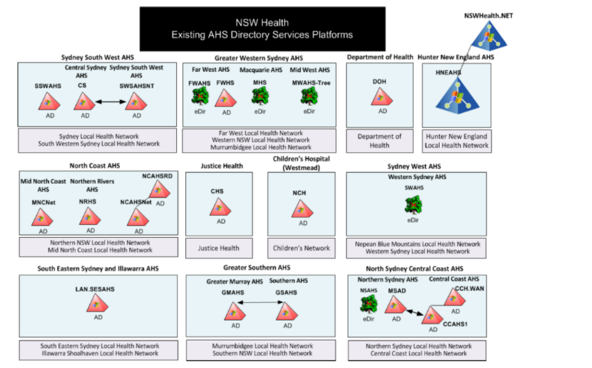
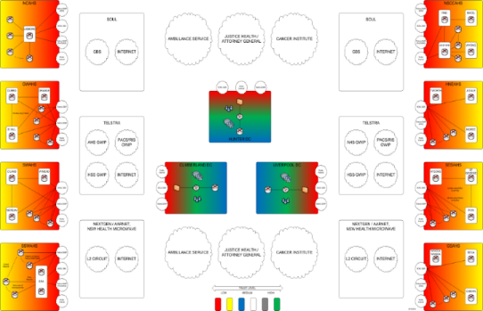
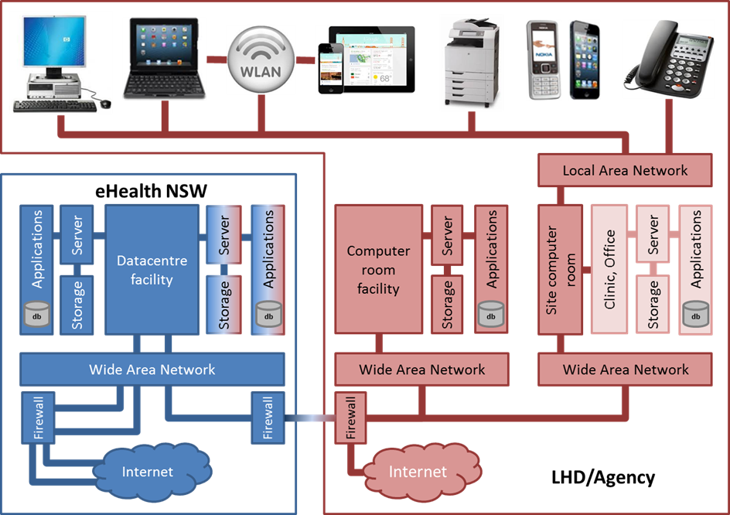
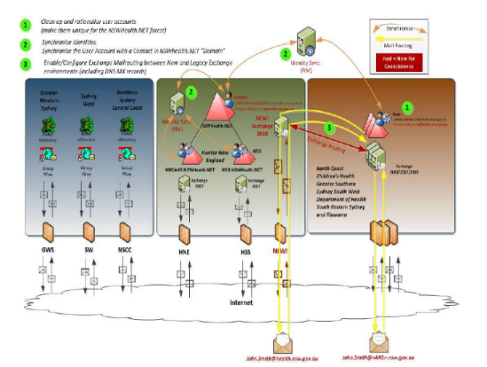
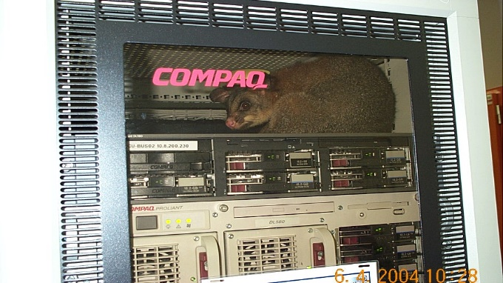
Where we came from
158
Our challenge is to work with NSW Health to deliver good outcomes
The only certainty in the future is change
Notes:
There is NO mandate, change has to be collaborative and achieved through consensus
Data Centers are aging and expensive to maintain
3 corporate data centres
25 other data centres (that we are aware of)
Significant percentage of campus cabling is at a CAT 4 standard
Each LHD and Agencies has implemented infrastructure against local standards to varying degrees of success
You name it we have it
15 Wide Area Networks
22 Internet Gateways
60% of sites have less then 2Mbps capacity with no Quality of Service
Hard to deliver Video Based services
Not in a position to support next generation high capacity low latency requirements
No end to end management system in place, fault identification and rectification difficult are time consuming
Environments held together through unmanaged static routes
Over 50 different mail domains with a mixture of Outlook and GroupWise
Telephony solutions deployed on a campus by campus basis

Slide 159
The lessons so far
Being given a mandate for change does not help
Innovation will come from those close to the clinician, patient and carer
eHealth NSW’s Infrastructure focus is on providing reliable tools and systems for users and developing innovative solutions for Health Entities.
  Single manageable and predictable network
  Virtual front end, network and back end
  Common hosting and delivery
  Same / single sign-on
  Mobility support
  End-to-end integrated video

Slide 160
The path to a digital foundation

Slide 161
Our Infrastructure approach
Phase 1
2010 to 2013
Phase 2
2012 to 2015
Phase 3
2013 to 2019
Phase 4
2017 onwards

Slide 162
The foundation pillars of the digital enterprise

Slide 163
Our foundations – The Health Network
The Health Network is a ubiquitous state-wide network connecting the Health Data Centres to all Health facilities
It is intelligent and self-healing and provides multiple 10 Gig and 1 Gig connections
to acute facilities across the state
It securely interconnects with universities to facilitate and foster research
It provides secure internet and a range of other services
Our Foundations
The Health Network

Slide 164
Our foundations – The Data Centres
Moves all physical data centre systems to the NSW Government Data Centres (GovDCs)
  First eHealth NSW then all of the LHDs
  Service provision moves from CAPEX to OPEX
The data centre becomes virtual, offering services from a range of sources:
  eHealth NSW from our equipment in our computer rooms
  From the Government Marketplace established in GovDC
  From third-party data centres in NSW and across Australia
  From the Hyper providers (Azure, Amazon Web Services)
Our Foundations
The Health Network
The Data Centre

Slide 165
Our foundations – The Wireless Core
The Wireless Core provides a hierarchical management system across all of NSW Health’s wireless access points
It allows eHealth NSW to deliver Enterprise Wide SSIDs
  EduRoam, Patient WiFi, Ford Ordering are first examples
It will support hundreds of thousands of ‘people and things’ to securely authenticate to our environment and provide priority access to critical clinical and corporate systems
It will support ubiquitous BYOD across NSW Health
Currently in interim deployment, with full system go-live by December 2017
Our Foundations
The Health Network
The Data Centre
The Wireless Core

Slide 166
Our foundations – State Wide Infrastructure Services
State Wide Infrastructure Services provides:
  A single identity across NSW Health (200,000 down)
  A single email system across NSW Health (165,000 down – 5,000 to go)
  A single messaging archive solution
  Mobile device management
  An enterprise-wide virtual desktop (first 30,000 about to commence deployment)
  A single file and ‘follow me’ print solution
The most critical aspect is the identity
  Identities now being provided to non-Health personnel and identity federation is occurring
The Health Network
The Data Centre
The Wireless Core
State Wide Infrastructure Services

Slide 167
The next stage of the journey

Slide 168
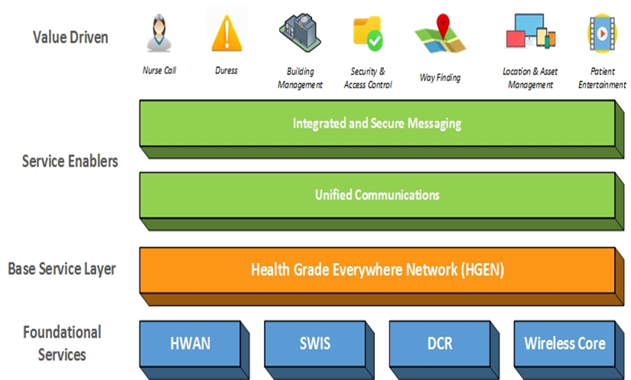
An enterprise approach to Infrastructure
Initial Focus Area
Consistent Campus Solutions

Slide 169



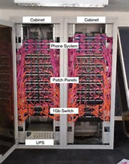


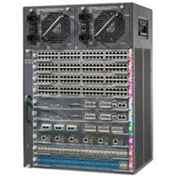

What could be included in consistent campus solutions
The Health Grade Enterprise Network (HGEN)
Cabling Systems
Facilities Infrastructure
Wireless Infrastructure and
Distributed Antenna Systems
Local Area Networks

Slide 170
What is the Health Grade Enterprise Network (HGEN) initiative?
A strategic procurement activity
Delivering value for money through all of Health activity
Delivering a consistent and predictable performance
Targets investment where it is needed
Drives ICT to delivery against a base operational metric
Delivers evergreen outcomes
Leverages and upskills our people

Slide 171
Our Health campus challenges and opportunities
Current challenges
Our opportunities
Inconsistent Campus ICT Infrastructure
A Brownfields / Greenfields Divide
ICT infrastructure investment needs to keep up with clinical demand
Key clinical benefits may be at risk if investments in campus infrastructures are not sufficient to support the Statewide clinical and corporate systems being deployed
On-campus network infrastructure is CAPEX intensive and lacks flexibility to support the rapidly changing IT landscape
More consistency is required in support services across NSW Health
Procurement, service delivery and management approaches are in need of optimisation
Consistent and ubiquitous technology platform available across the Health cluster
Consistent and appropriate services through Greenfield and Brownfield facilities
A reliable platform to consistently deliver and support Clinical and Corporate applications across all facilities
Enforceable consistent service levels for clinical systems from information source to end user devices irrespective of location
Drive more value of the dollar spent on ICT infrastructure and related services
Modern procurement approach with service delivery based on clear operational and outcome metrics

Slide 172
Key benefits
Improved end-to-end performance for mission-critical systems
such as eMR and eMeds
Consistent and standardised service levels
Increased purchasing power by leveraging NSW Health’s size as one of Australia’s largest enterprises
Investment stability
Services delivered against common-sense operational cost metrics
Alignment with the eHealth Strategy for NSW Health: 2016-2026
Enabling infrastructure to be mobile and integration-capable

Slide 173
Where are we with HGEN
A Pilot only has been approved across the Westmead Precinct:
  Westmead Hospital
  The Children’s Hospital Westmead
  The new Central Acute Services Building
An RFT closes on 12 Nov to:
  Determine the Pilot provider
  Collect information to inform a state wide business case

Slide 174
Thank you

Slide 175
