Slide 1
Caring for Forgotten Australians, Former Child Migrants and Stolen Generations
An information package for aged care services

Slide 2
Copyright
© 2016 Commonwealth of Australia as represented by the Department of Health (except for historical images).
Historical images are used with the permission of the copyright owners.
Enquiries
Requests and inquiries concerning reproduction and other rights to use this publication are to be sent to the Communication Branch, Department of Health, GPO Box 9848, Canberra ACT 2601, or via e-mail to copyright@health.gov.au.
Disclaimers
While all care has been exercised in ensuring the accuracy of the information in this publication, the Department of Health does not accept any liability for any injury, loss or damage incurred by use of or reliance on the information.
The information in this publication is for general use and a guide only. The Department of Health is not providing professional or medical advice on any particular matter.

Slide 3
Purpose
Increase awareness about the following Care Leaver groups:
Forgotten Australians
Former Child Migrants
Stolen Generations
Recognise the emotional and physical issues which they may bring with them as they age and consider their on-going (or future) care needs.

Slide 4
Forgotten Australians
Up to 500,000 children were placed in:
foster homes
children's homes
orphanages
other institutions.
They came from all parts of Australia and all levels of Australian society.
Source: Care Leavers Australasia Network.
Archive picture of Ballarat Orphanage, Victoria.

Slide 5
Former Child Migrants
Thousands of children were brought to Australia as unaccompanied migrants from the UK and Malta and placed into institutions.

Slide 6
Stolen Generations
Children of Australian Aboriginal and Torres Strait Islander descent were forcibly removed from their families by federal and state government agencies and church missions, under Acts of their respective parliaments.
Source: Battye Library 74244P.
St Joseph's Orphanage, New Norcia, WA

Slide 7
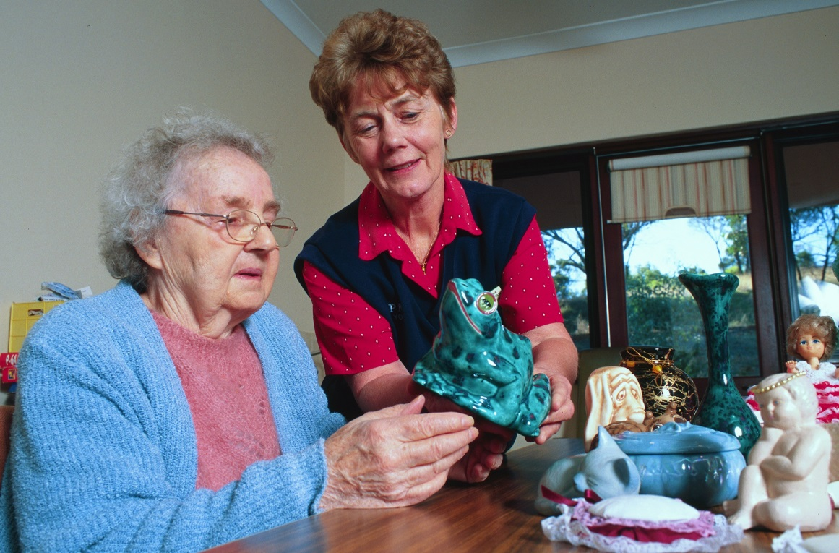
Understanding their needs
Working with members of these three groups requires an understanding of, and sympathy for, the mistreatment experienced during childhood.

Slide 8
Separation, loss and abandonment
‘Welfare departments knew what was happening in these places, the abuse, the lack of food, the lack of clothes, the lack of education, the separation from family… they knew.
No one cared.’
Source: Care Leavers Australasia Network.
Archive picture of Ballarat Orphanage, Victoria.

Slide 9
Separation, loss and abandonment in terms of belongings
Many may find it difficult to imagine things which, in an aged care setting, others may take for granted – such as sending their clothes to the laundry along with everyone else’s.
Source: Care Leavers Australasia Network.
Archive picture of Salvation Army Boys' Home, Bexley, NSW.

Slide 10
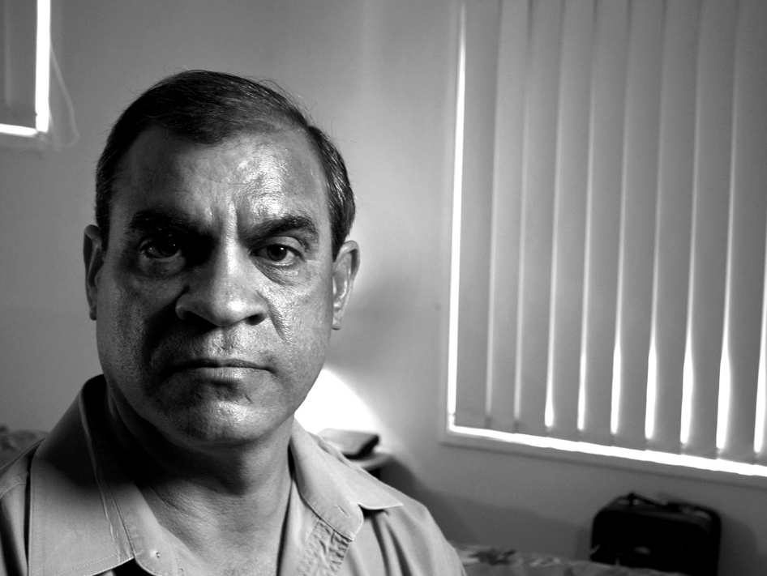
Exploitation and neglect
Harsh discipline and exploitation were often the norm for Forgotten Australians, Former Child Migrants and Stolen Generations. This has left a lasting impact on their mental health and emotional wellbeing, as well as on their physical health.

Slide 11
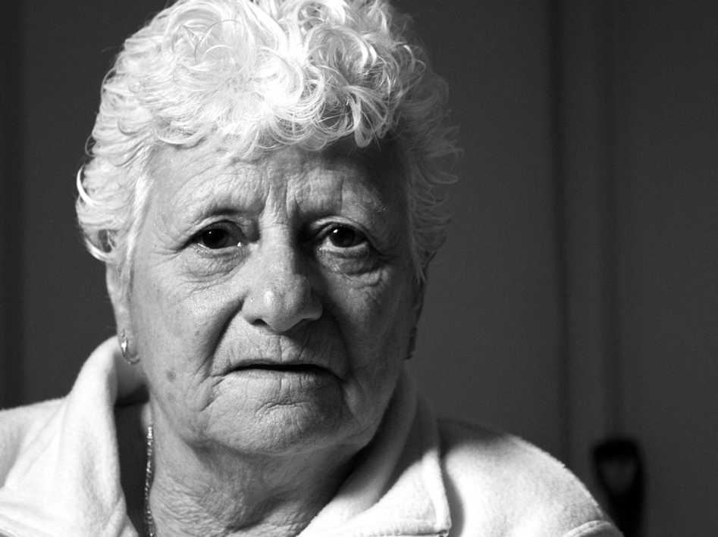
Exploitation and neglect in relation to education
Education was often denied to these groups. This has led to some having difficulties reading and writing, though many are too embarrassed to say so, for fear of humiliation.

Slide 12
Punishment and brutality
Most children who spent time in institutions experienced rigidly controlled childhoods.
They had strict schedules for getting up, eating, praying, washing and lights-out.
Source: Care Leavers Australasia Network.
Archive picture of Salvation Army Boys' Home, Bexley, NSW.

Slide 13
Physical or sexual abuse and privacy
Many people experienced physical or sexual abuse. This is particularly important to consider when providing daily care services, such as dressing, undressing or bathing.
Source: Care Leavers Australasia Network.
Archive picture of Salvation Army Boys' Home, Bexley, NSW.

Slide 14
Impacts
Aged care providers sometimes hear that people choose to live a life of homelessness or social exclusion. This is rarely the case. Instead people make what they perceive to be the better choice between two bad options.

Slide 15
Loss of identity and culture
Loss of identity
No birth certificates
Had their birth names changed
Known only as numbers during their early years
Loss of culture
Separated from their families in difficult circumstances
Forcibly removed from their families
Never reunited with family or cultural heritage

Slide 16
Aged care fears
Factors to consider:
Health status
Routines
Food
Belongings
Privacy
Authority figures
Locks
Education
Identity
Celebration
Culture

Slide 17
Conclusion
Given their past experiences, people from these backgrounds may be more sensitive to some aspects of life in aged care homes and institutional settings.
Workers in aged care know and understand about groups with anxieties and issues, health issues, language and cultural issues, dementia.
The issues and concerns of Forgotten Australians, Former Child Migrants and Stolen Generations are just as real.

Slide 18
Further information
The Information Package
Department of Health – https://agedcare.health.gov.au/careleavers
For Forgotten Australians
The Alliance for Forgotten Australians - www.forgottenaustralians.org.au
Care Leavers Australasia Network - www.clan.org.au

Slide 19
Further information
For Former Child Migrants
The International Association of Former Child Migrants and their Families - www.childmigrantstrust.com/intl-association
Child Migrants Trust - www.childmigrantstrust.com
Find & Connect Services - https://www.findandconnect.gov.au/

Slide 20
Further information
For Stolen Generations
National Stolen Generations Alliance - www.nsga.org.au
Link-Up Services - www.aiatsis.gov.au/research/finding-your-family/link-services
Aboriginal and Torres Strait Islander Healing Foundation - www.healingfoundation.org.au

